Slide 1
Ivsa - from local to the world
International veterinary students' association
UIA RoundTable 2014/10/23

Slide 2
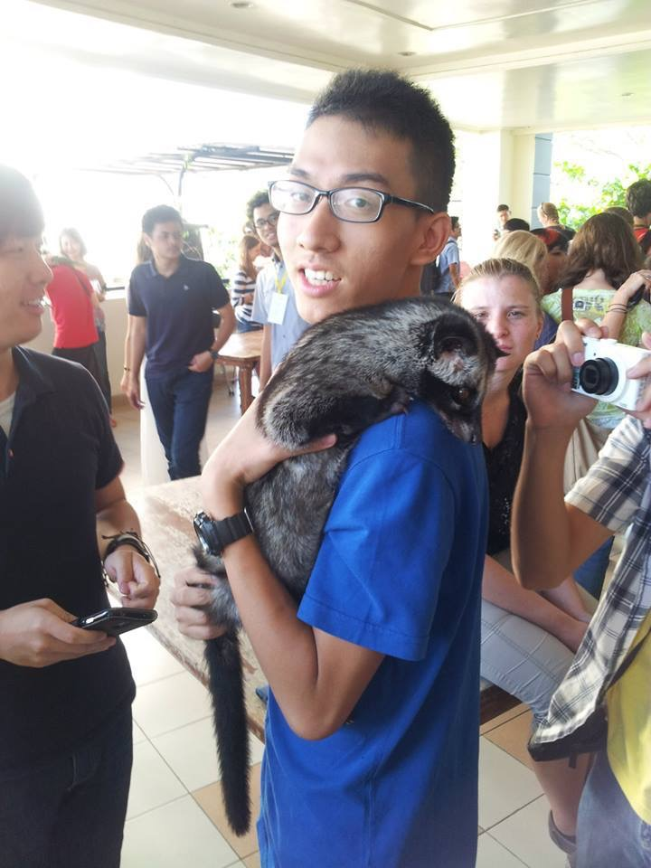
Henry
Ta-Heng Huang
黃大恆
Taiwan
IVSA Secretary to mod,2013~2014

Slide 3
1.introduction
2.management&
recruitment&
Experience delivery
3.crisis &victory
Today's topic

Slide 4
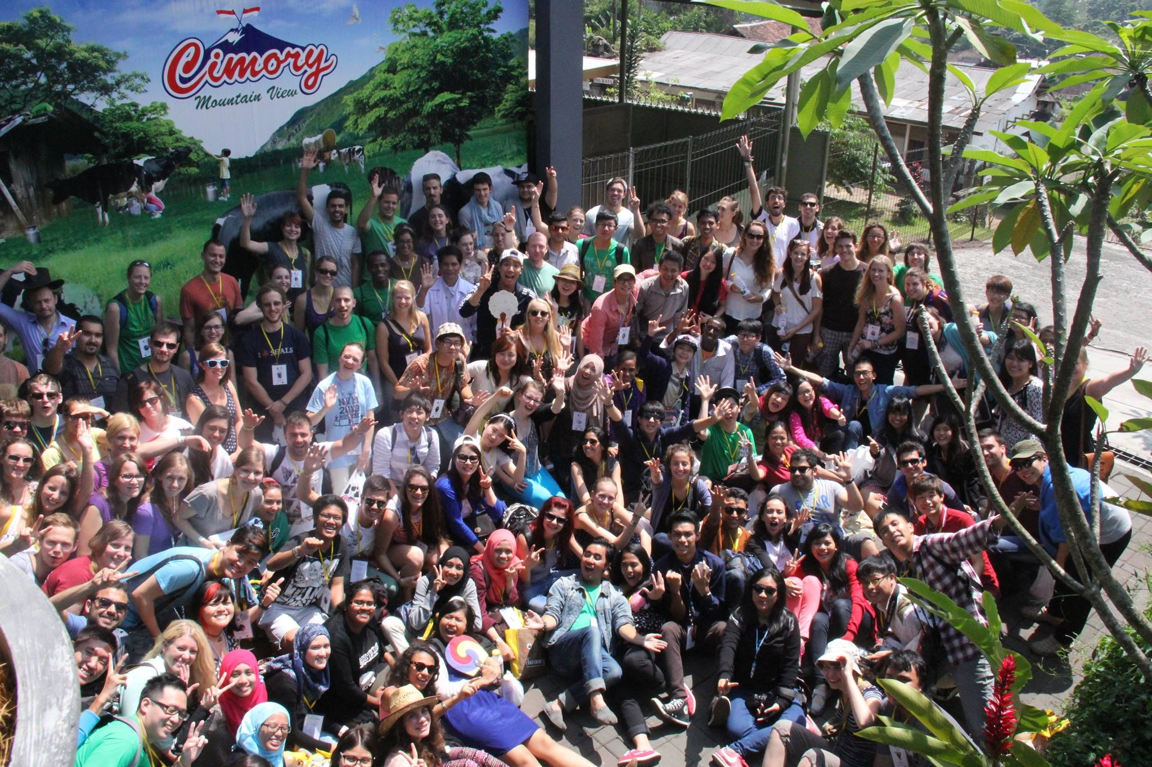
Hello! Kind regard from the world Vet students!

Slide 5
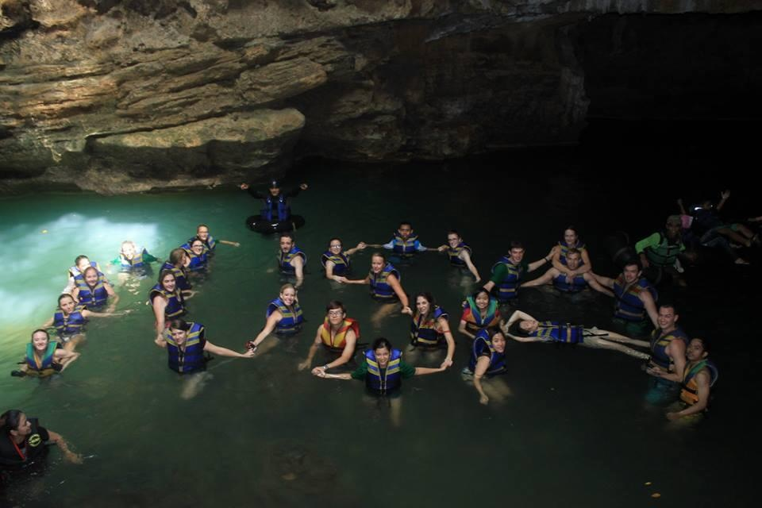
What is IVSA?

Slide 6
What is IVSA?
The International Veterinary Students' Association (IVSA) is a non-profit, non-partisan organization run by the volunteer efforts of veterinary students worldwide.
It was established to promote the international exchanges in veterinary skills, education and knowledge.

Slide 7
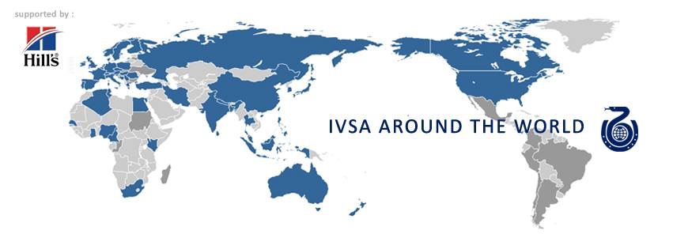
Until 2014 ,we have 85 member organizations in different veterinary schools from more than 50 countries
Over 10000 active members in the world

Slide 9
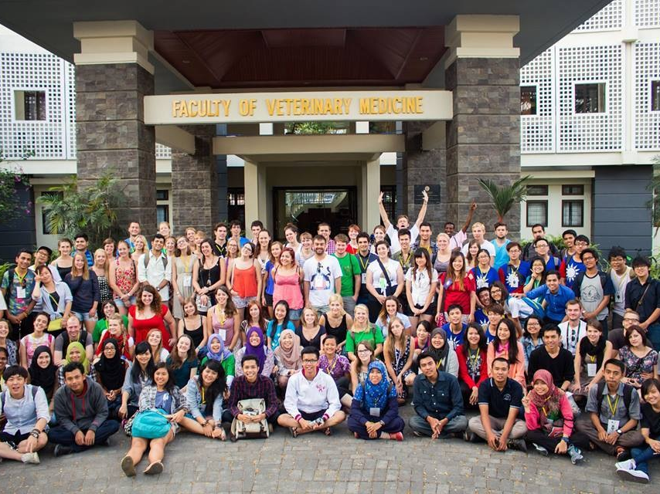
University Bogor agriculture ,Jakarta
2014 Congress members
164people 25countries

Slide 10
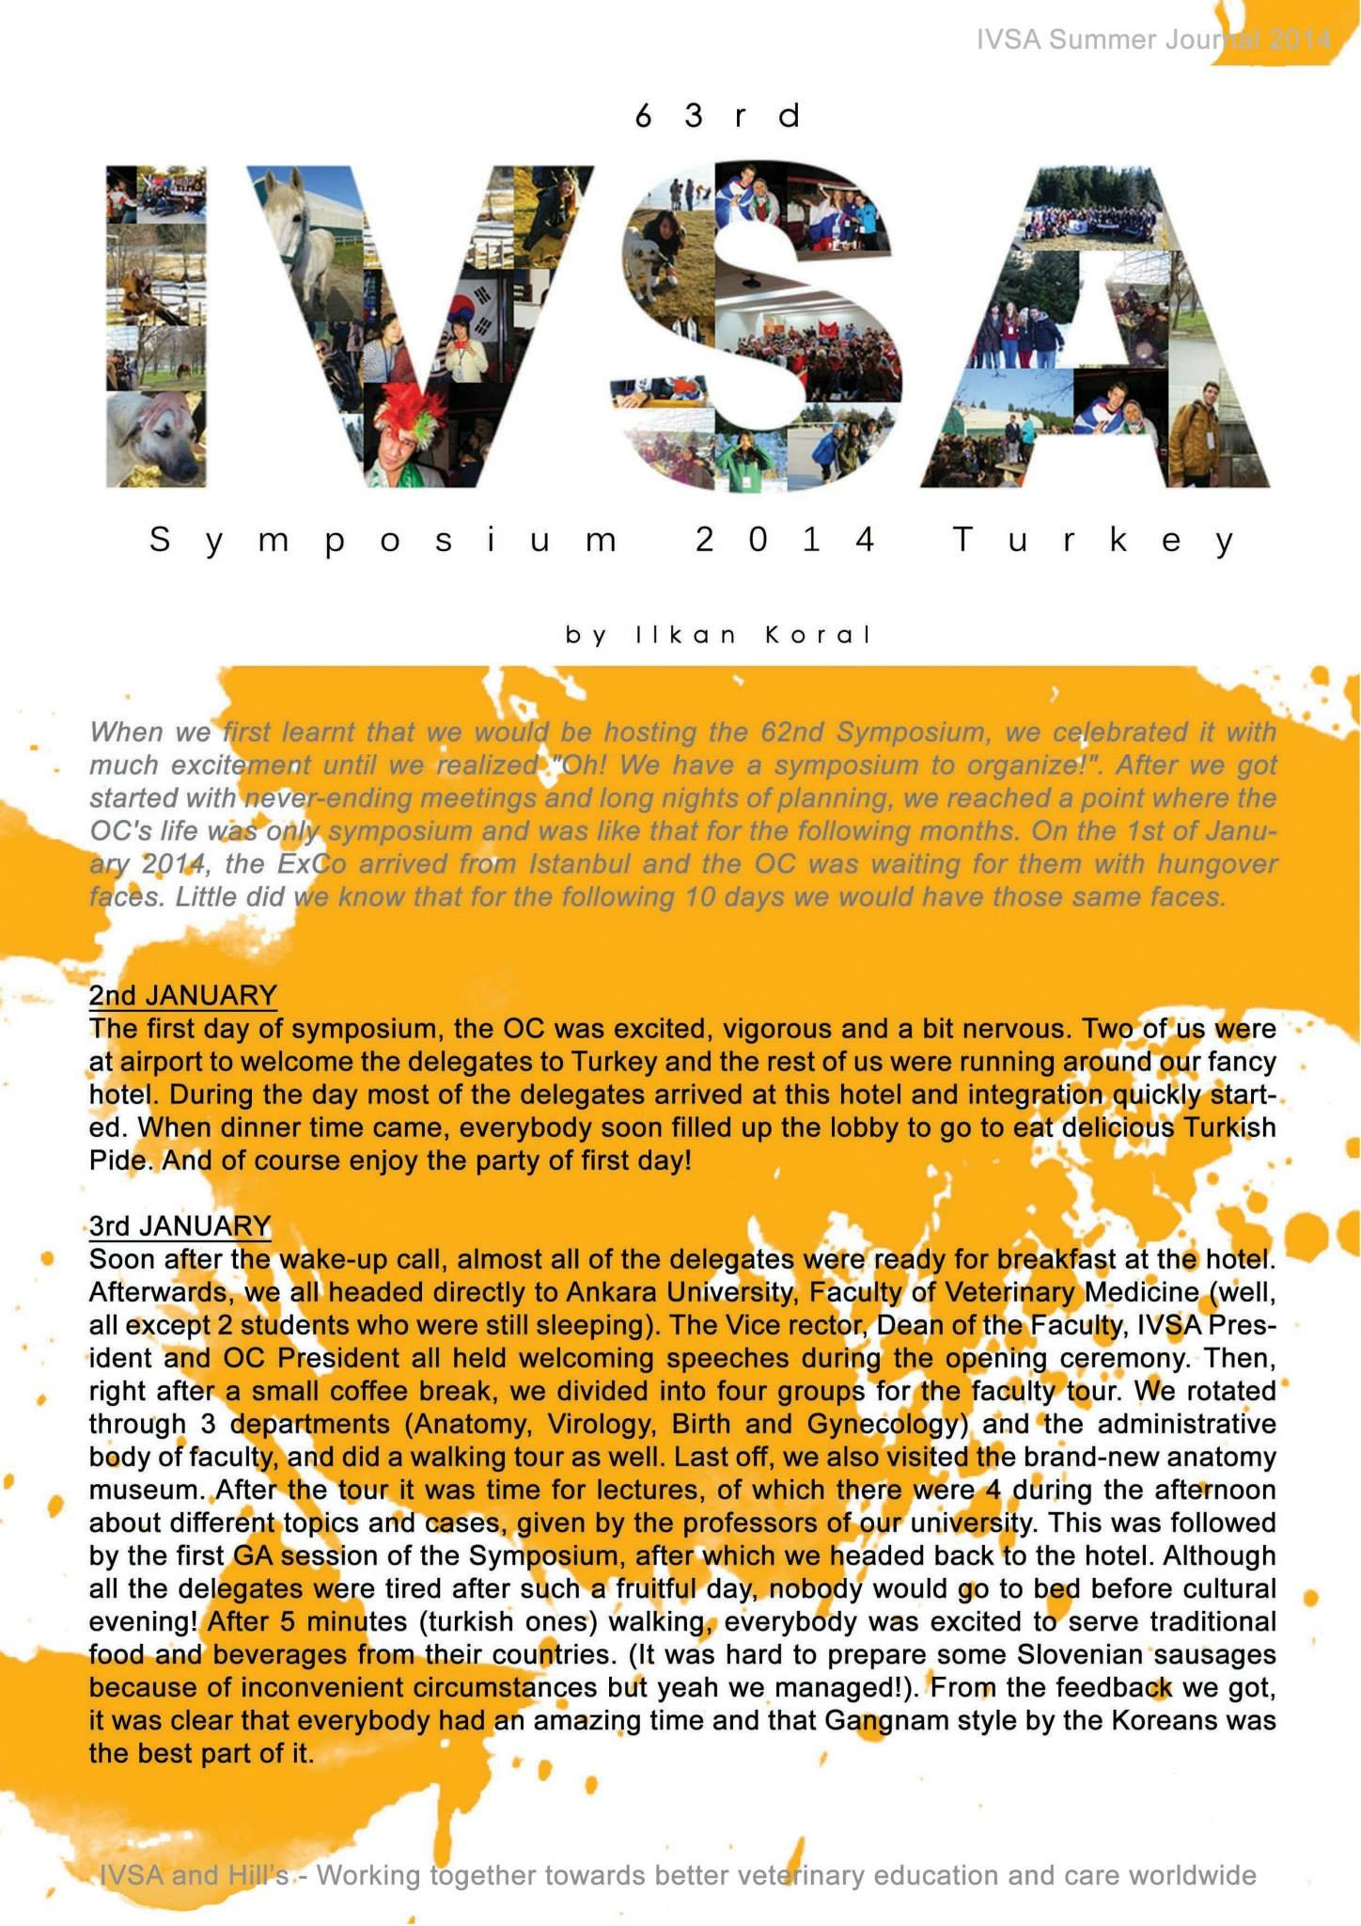
「United every vet students in the world, join & love the IVSA family.」
–Pim polka 2013~2014 president
The world is ours

Slide 11
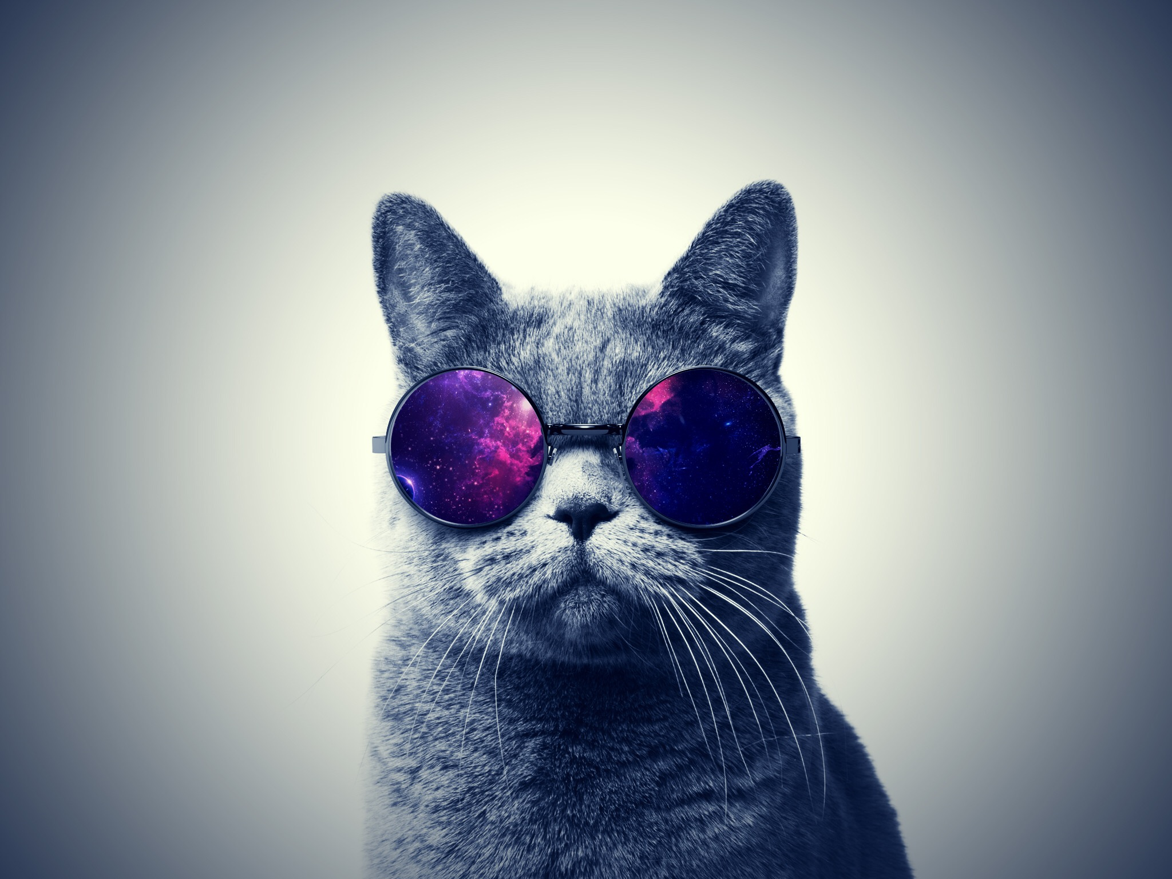
Management
Recruiting
Experience delivery

Slide 12
Management

Slide 14
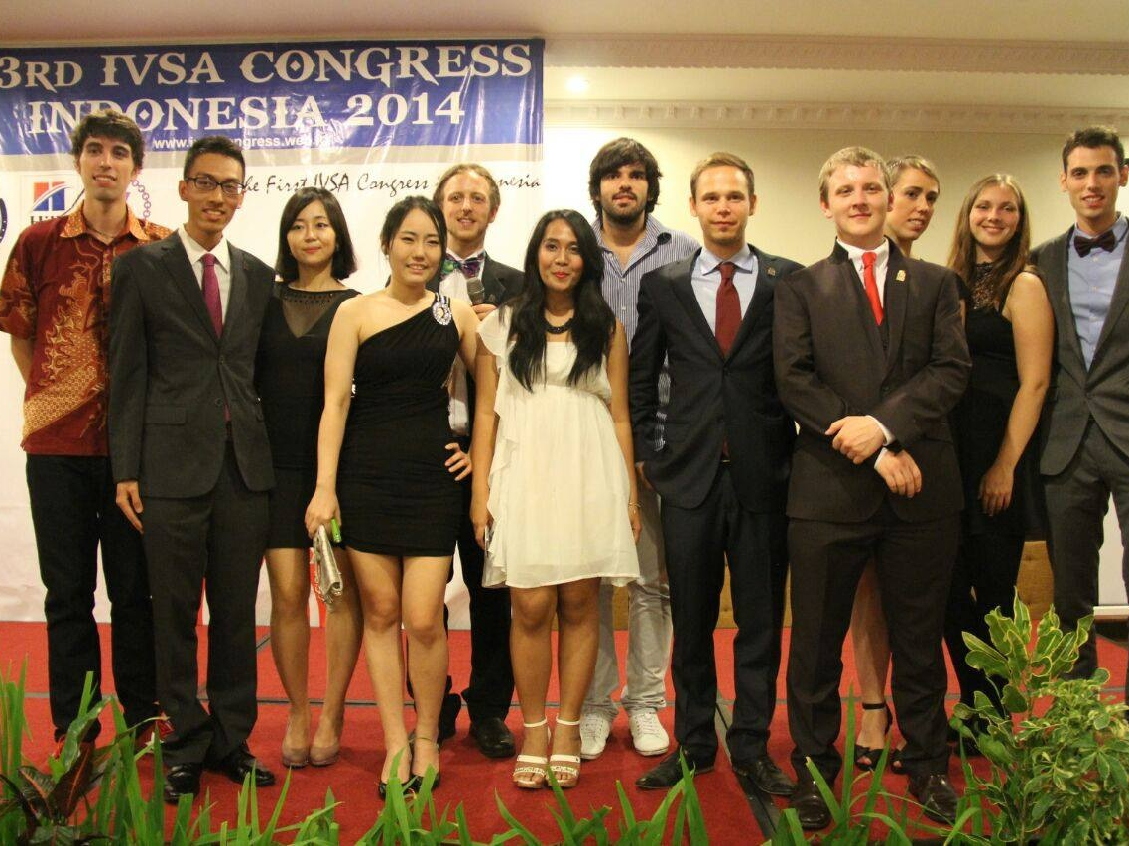
Exco team 2013~2014

Slide 15
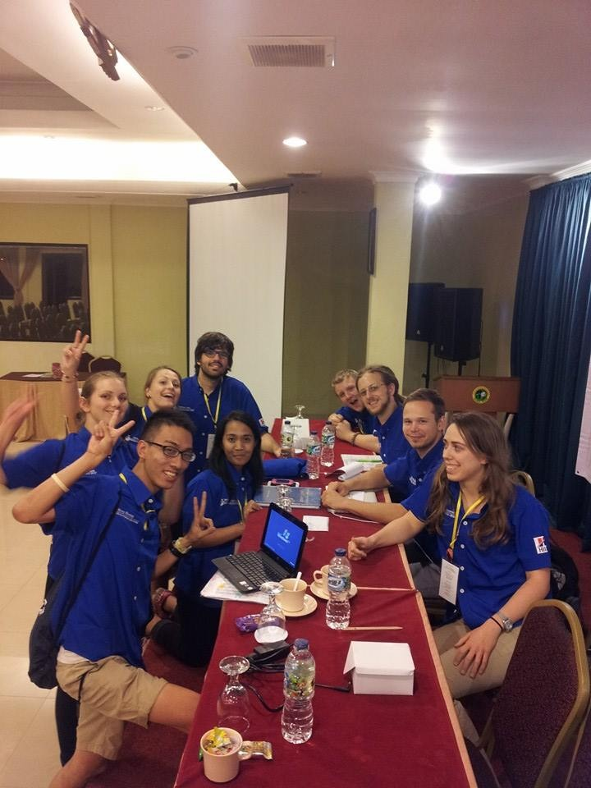
Monthly Report
Online Skype Meeting
every two months
Offline(Live) Meeting
four times a year

Slide 17
Exchange
Officer
Mod
&
Secretary
Local Chapter
Member

Slide 18
Recruiting

Slide 19
Slogan:Vet students around the world,We need you!
Training in local chapter

Slide 21
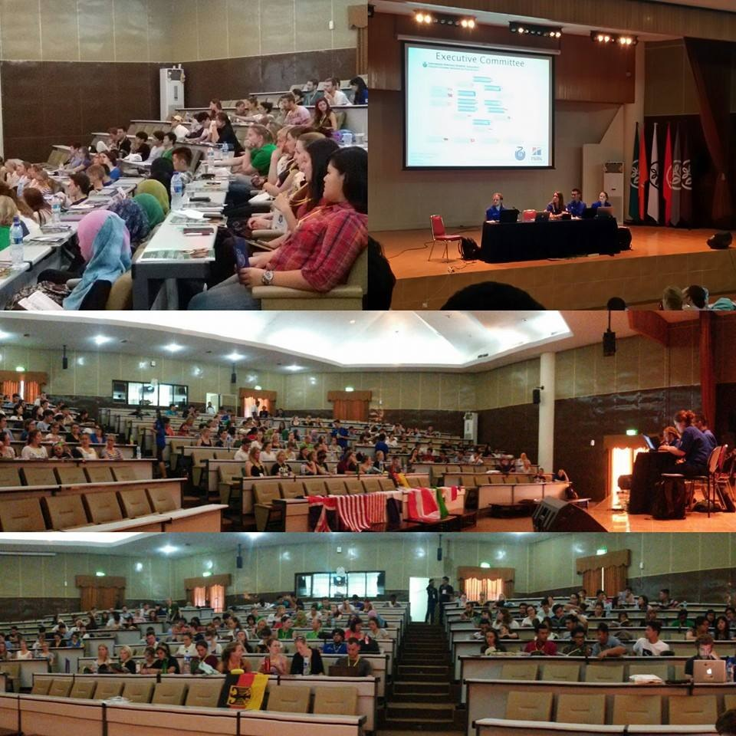
Up to six
General Assembly
Nominations Period

Slide 22
Victory & crisis

Slide 23
Communication

Slide 24
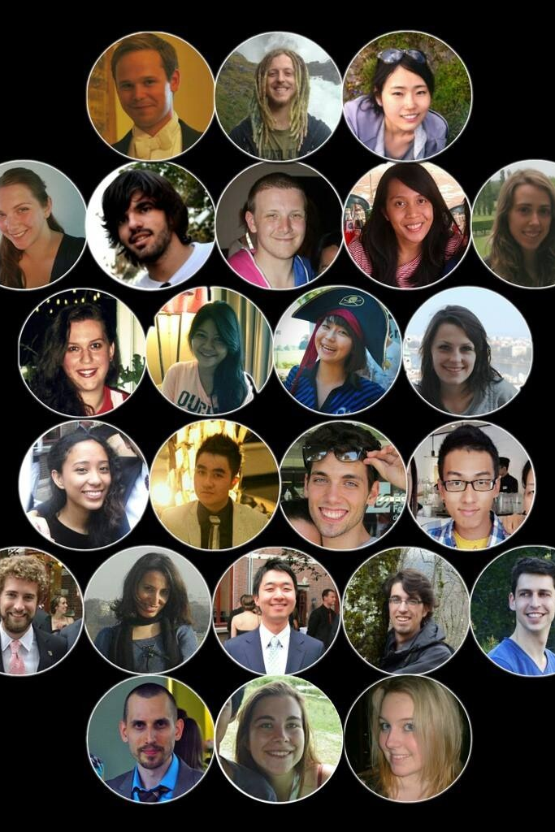
Global
Exco team
Executive committee

Slide 25
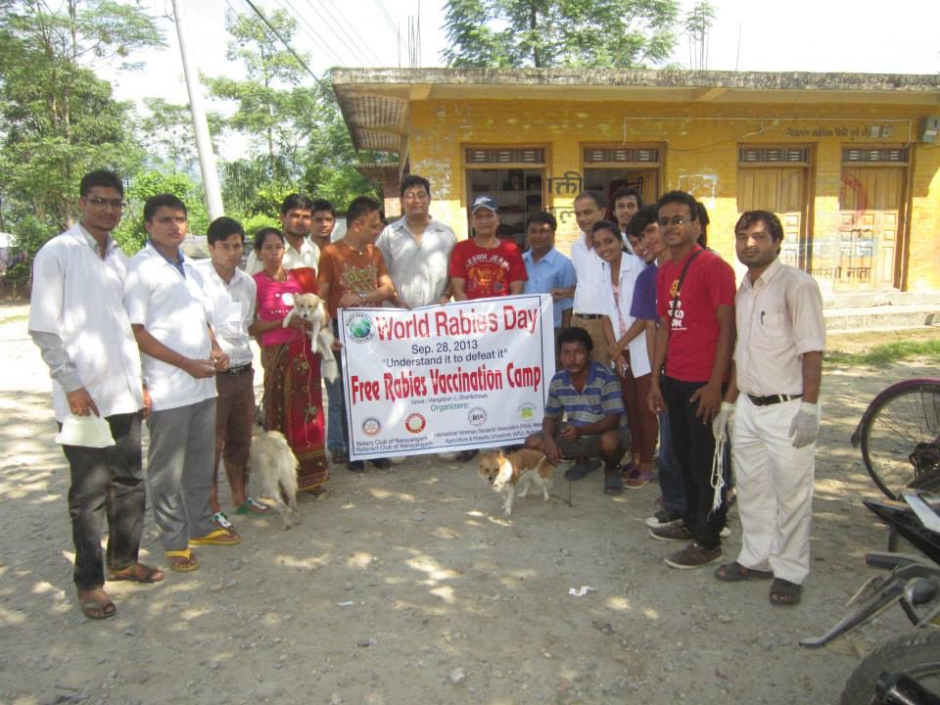

Slide 27
