Slide 1
Building Membership Value through Connections and Engagement Greta Kotler, CAE ASAE 22 October 2014

Slide 2
Outcomes
Associations Today: Contributions and Challenges
Getting Time and Attention from busy professionals
Highlights of new ASAE Foundation Research
Engaging Your Members and Connecting them to Value
Discussion and Next Steps for You

Slide 3
Contribution of Associations
Associations Enrich Lives
Through volunteerism, creating standards of safety and quality, specialized expertise and citizenship with communities around the globe.
Associations Impact the Economy
Through industrial development, product and service innovation and facilitating domestic and international business.
Associations Maintain Competitiveness
By committing resources to life-long learning, professional development, mentoring and research.

Slide 4
Challenges to Membership Today
Doing More with Less
Time to participate
Getting to know members at a deeper level
Getting their Attention: Communicating in an appropriate way
Keeping member’s interest in continuous engagement

Slide 5
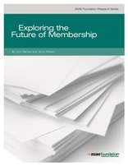
ASAE Foundation Research
Membership in Context: Providing Value to Members Where They Are
The Impact of Other Decision Makers: Engaging Influencers to Get New Members
Changing Roles and Responsibilities
Curation of Information and Data
Removing Barriers to Change

Slide 6
Membership Context: How Do You Create Value?
Define value:
Members decide what has value
Value is validated by a member’s willingness to exchange money or time for something
Value changes
From Road to Relevance: 5 Strategies for Competitive Associations,
by Harrison Coerver and Mary Byers, CAE, Published by ASAE (2013)
Notes:
From: Road to Relevance: 5 Strategies for Competitive Associations, by Harrison Coerver and Mary Byers, CAE Published by ASAE (2013)

Slide 7
Membership Value
The number one reason individuals or companies join an association is because they believe that association will help them solve a problem
The End of Membership as We Know It: Building the Fortune-Flipping, Must-Have Association of the Next Century by Sarah L. Sladek, Published by ASAE (2011)
Notes:
Right now, the number one problem most people are facing is likely related to their finances. They economy has forced people out of jobs, cut into their savings, and jeopardized their futures.” (pg. 39)
Don’t nickel-and-dime; members want more from their membership

Slide 8
Know Their Business
What problems are they trying to solve?
What is keeping them awake at night?

Slide 9
Membership in Context: Walk in Your Member’s Shoes
What are your member’s objectives?
Where are they in their careers or their business development?
What can you provide that they can’t provide themselves?

Slide 10
Anticipate
Learn about the Environment in Which Your Members are Working
Look at the Trends and What is Coming
Anticipate their Issues
Be Prepared and Offer Solutions
Anticipate change – not just respond to it

Slide 11
Provide Unique Knowledge
What Can You Do That Your Members Cannot Do?
Research
Industry Trends
Economic Trends and Impact
Other initiatives
Notes:
Trade Associations may even have a Chief Economist to serve the industry.
Trade, Professional societies and Federations can provide research on the industry or profession that companies, individuals, or organizations cannot provide themselves

Slide 12
Content Curators: Be Their Trusted Source of Content
Build Their Trust
Be a curator of content
Help them through the Clutter
Give them the vetted solutions – and best practices
Notes:
ASAE example of our Resource Center where we used to send out several pages of resources
What they want it the best solution; the vetted solution
They want us to go through the clutter and provide the best information or tool for their problem
That can sometimes be a real

Slide 13
Create Career Value
Career Development is particularly important to younger members
Show them pathways to their goals
Offer Certification and
opportunities to enhance their resumes

Slide 14
Provide Essential Learning
Learning
Do your members engage in workshops and seminars?
Determine what skills and knowledge they need to solve their problem
Create a learning experience that will stand out from the rest

Slide 15
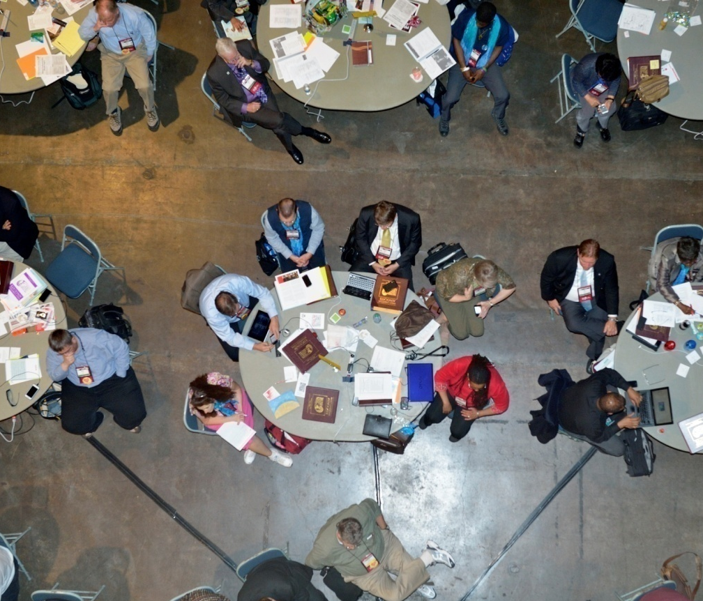
Conversation Starters
Please discuss with a colleague at your Table
What is one thing you do now that you believe provides exceptional value?
What is one thing that you could do in the future to enhance that value?

Slide 16
Connecting Members to Value
To Solutions
To Knowledge
To Learning
To Career Opportunities
To Each Other
Notes:
From: 199 Ideas: Member Service and Engagement, published by ASAE (2011)

Slide 17
Making Connections
As an association professional, you are in the best position to help members meet each other.
Get in the Habit of Connecting Members, Associations Now Aug. 13, 2014

Slide 18
Connecting Members to Value

Slide 19
Connecting Through Technology

Slide 20
Collaborate Site

Slide 21
Conference Mobile App

Slide 22
Associations Now

Slide 23
Conversation Starters
Please discuss with a colleague at your Table
What are Your Best Examples of Connecting Members to Value?
(with or without technology)
What is Working Well?
What Might You Try in the Future?

Slide 24
Start at the Beginning
Within 24 Hours
First 30 days
30 to 60 days
Provide something unique
Engage and Connect
them right them right away
Sheri Jacobs, The Art of Membership, John Wiley & Sons, 2014, p. 171

Slide 25
Connecting New Members
Encourage new members to join a component, special interest group, or community of practice.
Engage new members using high-touch techniques.
199 Ideas: Member Service and Engagement, published by ASAE (2011)
Link them up with like individuals and organizations from which they will derive value
Recognize new members.
Notes:
From: 199 Ideas: Member Service and Engagement, published by ASAE (2011)

Slide 26
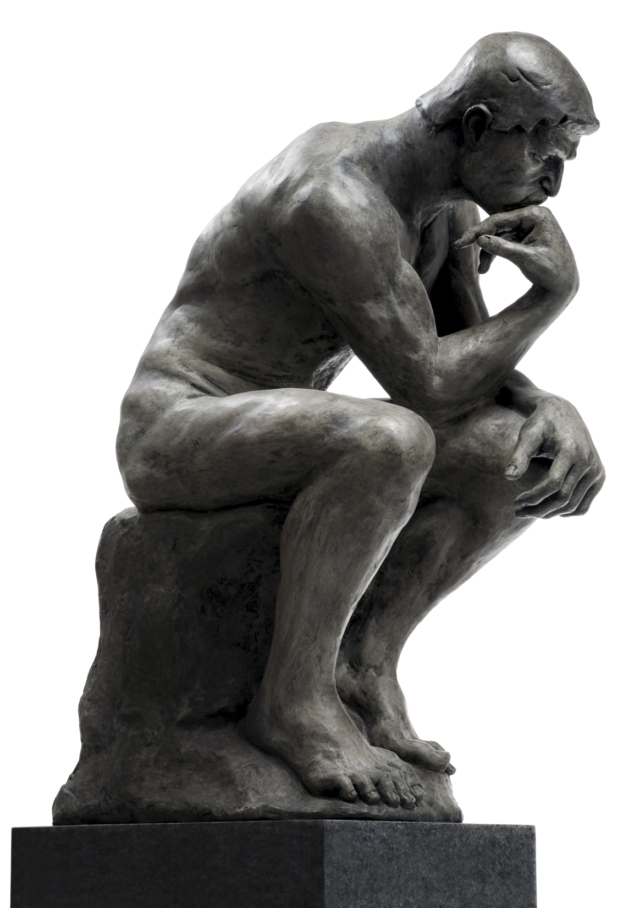
How To Think About This
Ask Yourselves…
What is Unique About Your Organization?
What is Unique About Your Offerings?
What Can You Provide that Individuals or Companies Can’t Get Elsewhere?
How can you best Connect Your Members to Value?

Slide 27
Your Important Role in Association Management
YOU CAN:
Build new skills
Expand your knowledge
Work with a variety of stakeholders
Develop your career opportunities
Work in a dynamic environment
Develop new collegues
Make a personal contribution

Slide 28
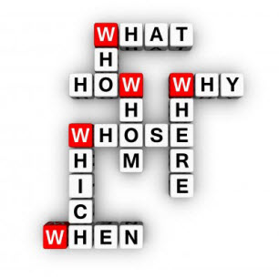
Questions and Application
Your Questions?
What is one thing that you will do back home to connect your members to value?

Slide 29
THANK YOU
Contact Information
Greta Kotler, CAE
Chief Global Development Officer
ASAE
gkotler@asaecenter.org
+1.202.326.9506/+1.202.207.8083

