Slide 1
Using Technology as Drivers for Growth & Engagement
Chris Champion
Secretary General International Federation of Municipal Engineering
sec-gen@ifmeworld.org
Former CEO, Institute of Public Works Engineering Australasia

Slide 2
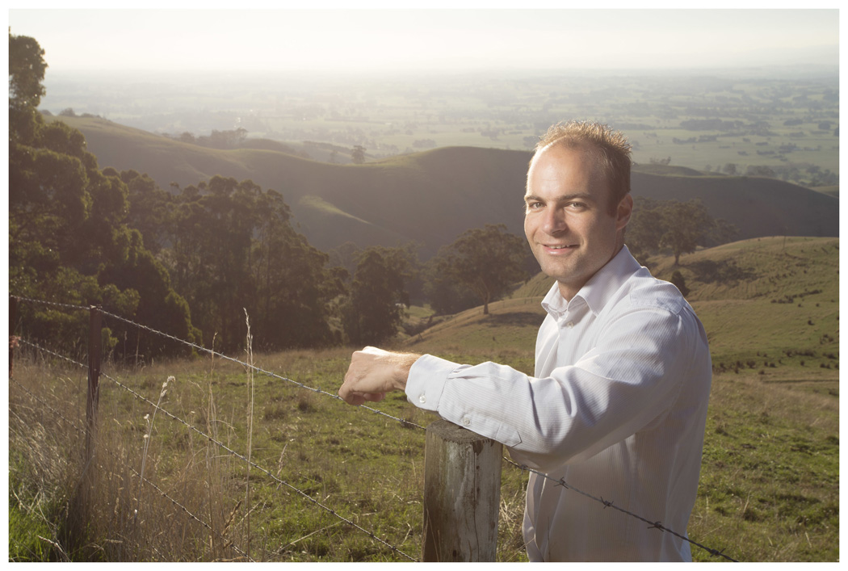
It starts with Kurt

Slide 3
then Ray

Slide 4
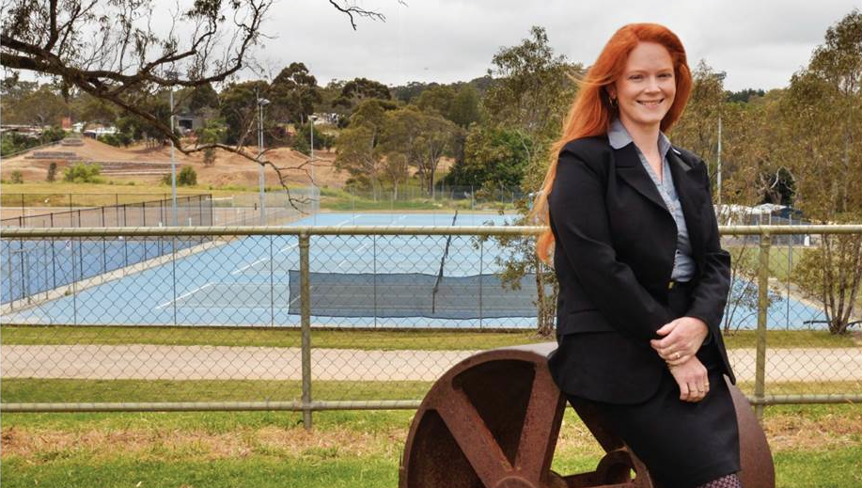
and Megan

Slide 5
IPWEA is doing a good job capturing
Kurt, Tim and Megan’s attention
No.1 for member engagement & overall performance

Slide 6
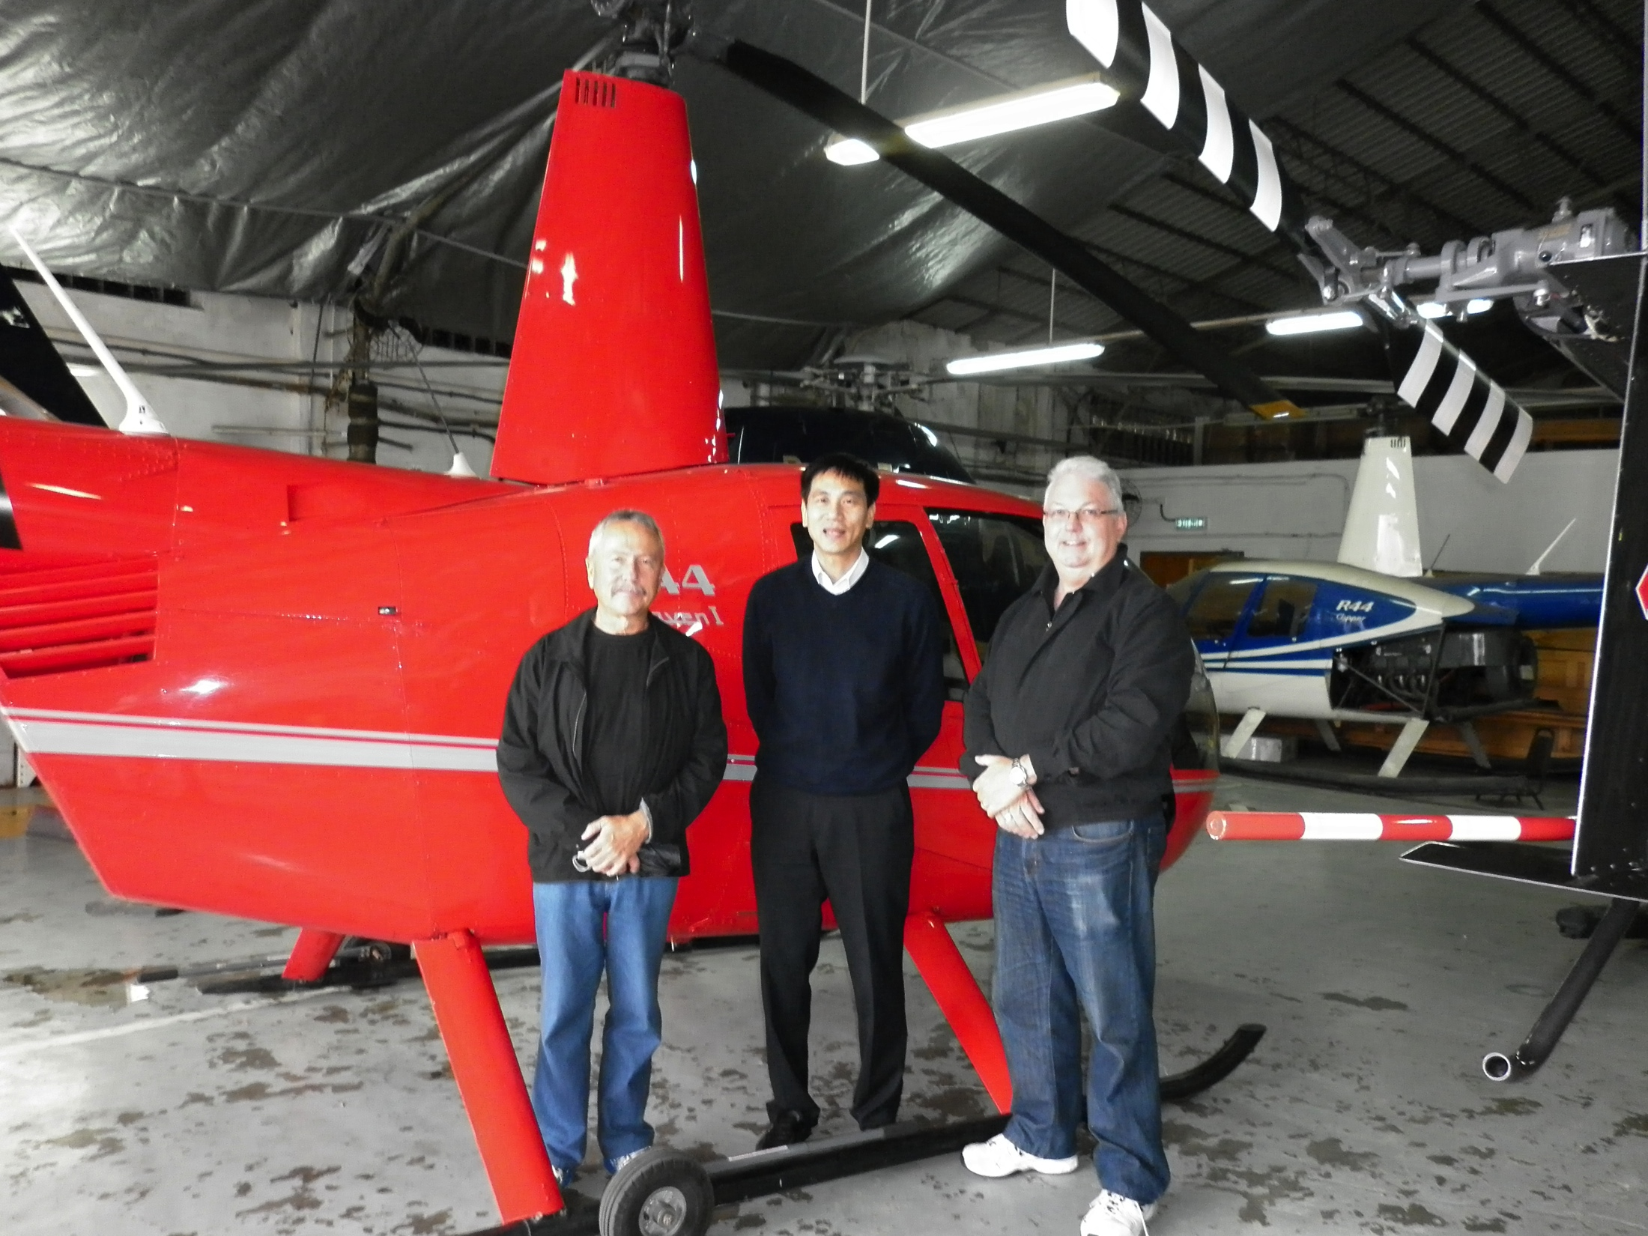
and international attention
US Federal Highways
Hong Kong Police

Slide 7
Broader objectives
Increase non-member awareness globally
Raise profile as quality, attractive member association
Promote IPWEA products & services
- technical manuals, publications, workshops & conferences
Increase member engagement through interaction
Maintain advertising support

Slide 8
Main reason for joining IPWEA
“access information that will assist me to perform my role”

Slide 9
92% of members intend to renew 2015 up from 88% in 2010

Slide 10
IPWEA informs, connects, represents & leads public works professionals

Slide 11
Publications
Business model
Non-Revenue Services
Subscription services
Knowledge transfer

Slide 12
What can I learn from IPWEA?

Slide 13
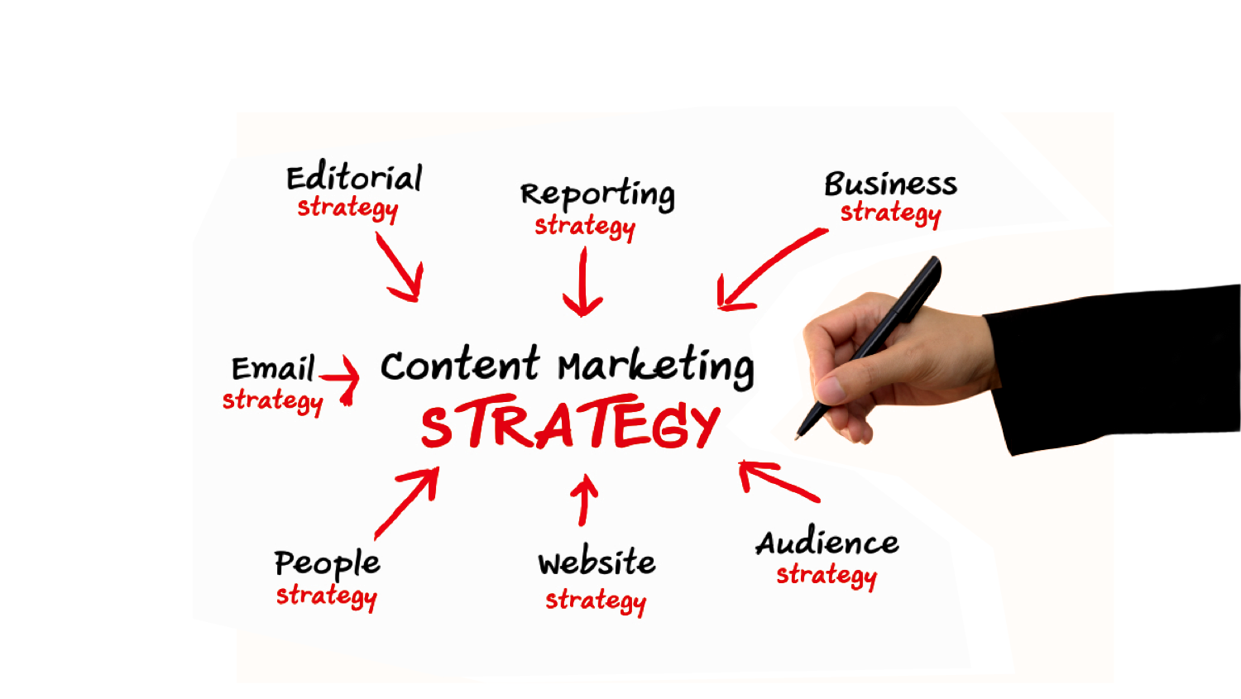
Strategy is key to (content) marketing

Slide 14
IPWEA was 2,200 members 4,000 hits/m and 8,000 prospects
…just 3 years ago

Slide 15
IPWEA was 2,200 members 4,000 hits/m and 8,000 prospects
…just 3 years later
IPWEA now 4,000 members 20,000 hits/m and 20,000 prospects

Slide 16
Membership has now grown 100% prospects 150% & hits five times
Communities
(private forums)
launched
New communication launched (eNewsletters, events emails and magazine)
NZ members start receiving emails from centralized database following merger with IPWEA
Website
launched
Monthly visits 5x increase from 4,000 to 20,000+ hits per month
Visits
5

Slide 17
Revenue growth another strong measure
Revenue Growth 1999-2014

Slide 18
We have embraced 3 key drivers
integrated systems
integrated content
innovative teams

Slide 19
innovation.
systems.
content.

Slide 20
systems.
Integrated systems are the foundation

Slide 21
A robust contact database was the start
systems.

Slide 22
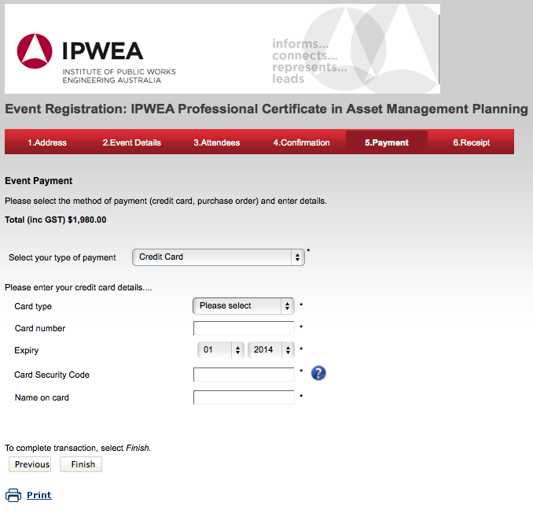
Firstly set out to integrate events regn & financials

Slide 23
Launched new website Nov 2011

Slide 24
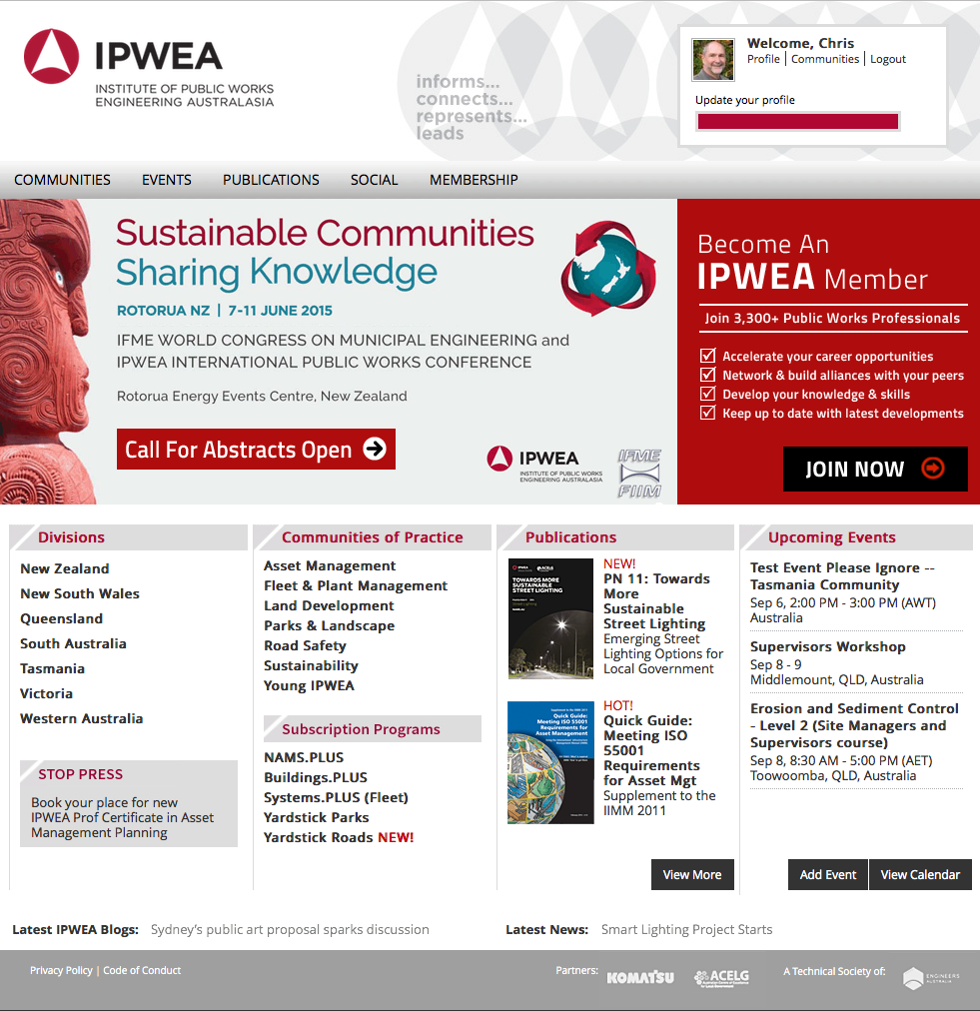
Launched new website Nov 2011 Refreshed July 2014 Responsive Oct 2015

Slide 25
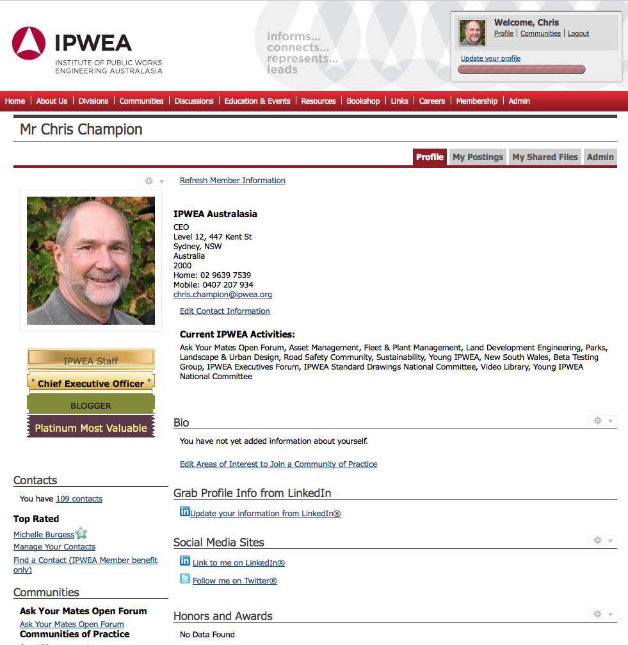
Database sync’d with website profiles important

Slide 26
Private online communities a key decision private vs LinkeIn
systems.

Slide 27
IPWEA private communities auto-subscribed all

Slide 28
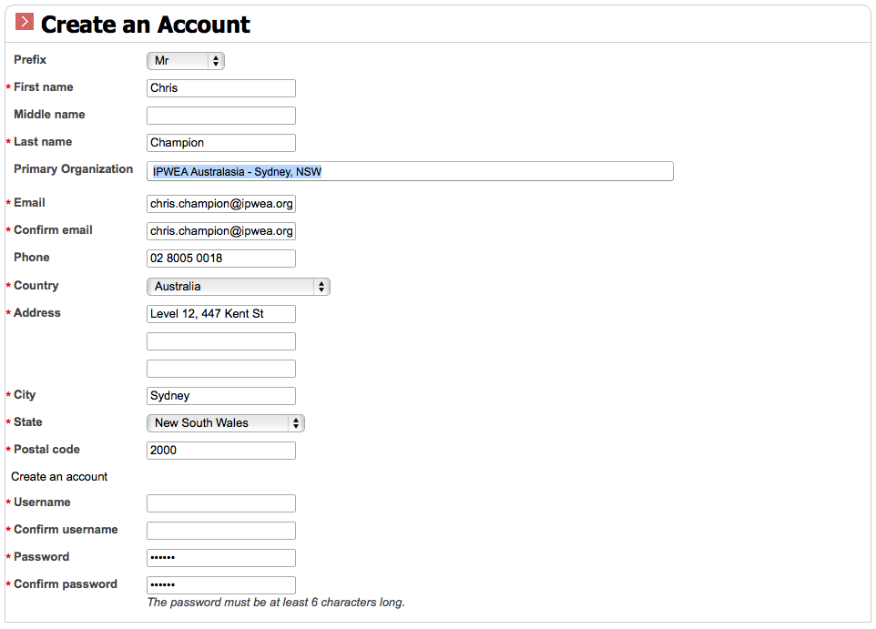
Allowed free web members all-access

Slide 29
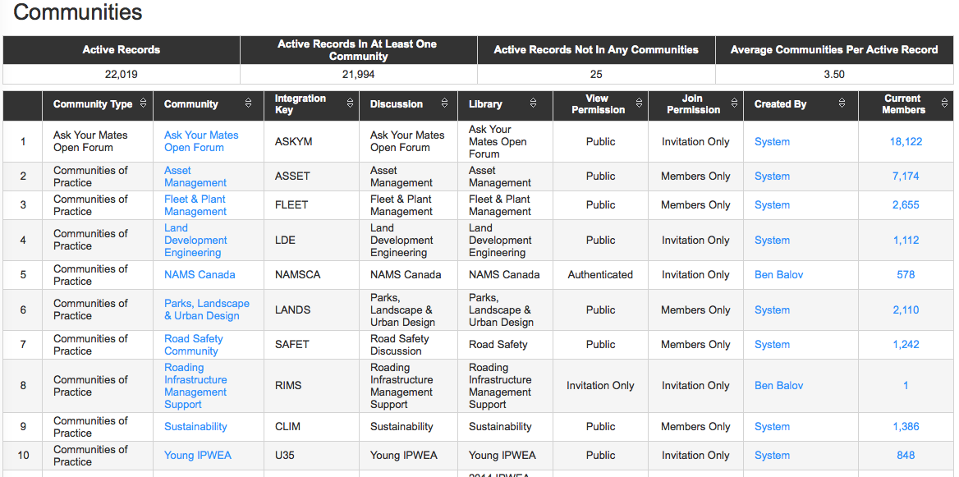
Building our communities, not LinkedIn

Slide 30
Integrated email marketing was the foundation cap
systems.

Slide 31
Finally a single database

Slide 32
All roads lead to Rome + all contacts to one database
Buy publication
Sign up for newsletter
Register for event
Attend conference
Become a member
Single database
Subscribe to services
All Divisions

Slide 33
Professional consistent design across all channels

Slide 34
A robust contact database was the start Private online communities a key decision Integrated email marketing was the foundation cap
systems.

Slide 35
We have embraced 3 key drivers
integrated systems
integrated content

Slide 36
content.
Content is what we are building

Slide 37
Started as a magazine re-launch
content.

Slide 38
Pick-up magazine style not put-down advertorial tome

Slide 39
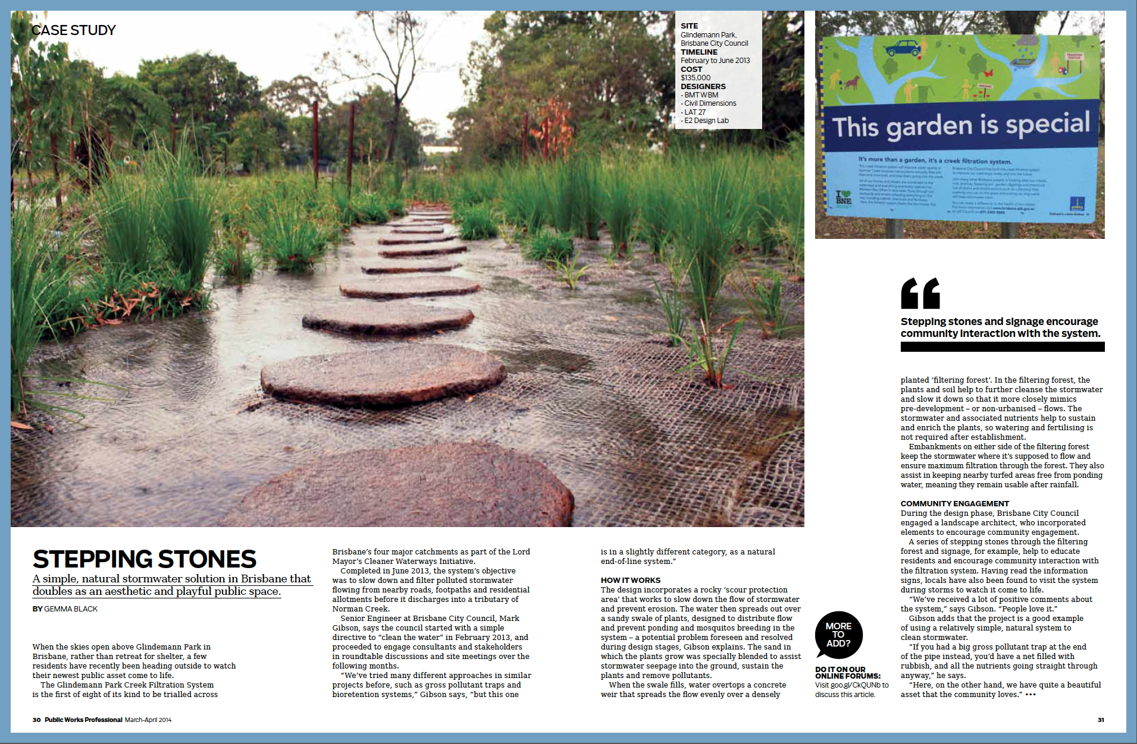
High visual design a major feature

Slide 40
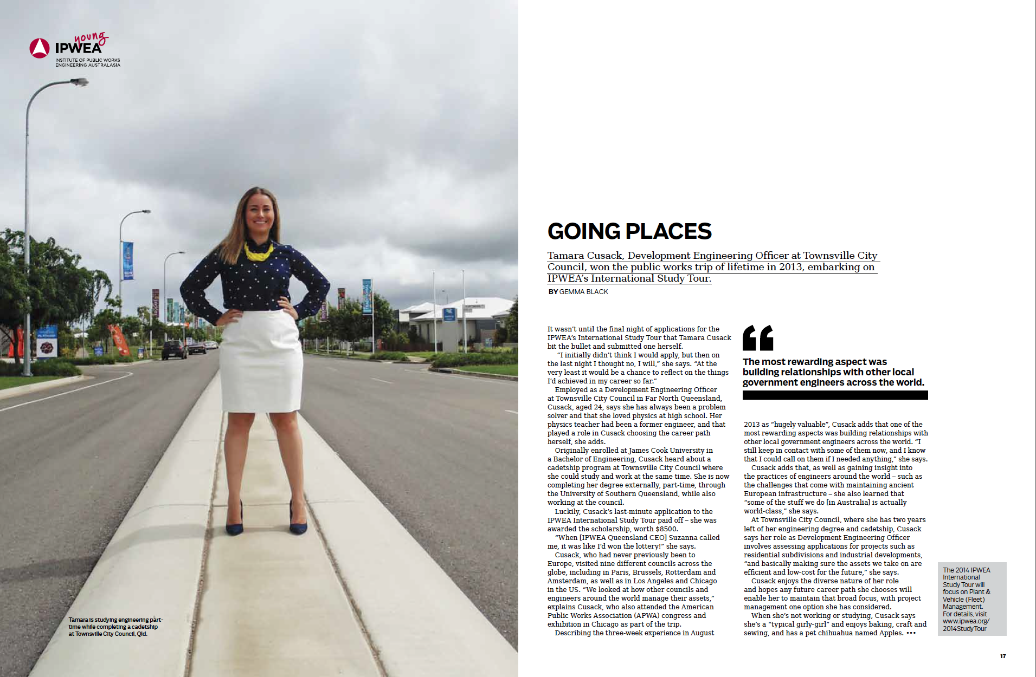
First focus on IPWEA objectives: members

Slide 41
Segmented e-newsletters opened new opportunities
content.
content.

Slide 42
Building our position in key markets

Slide 43
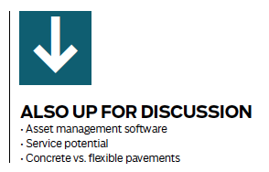
Forums are monitored for hot topics

Slide 44
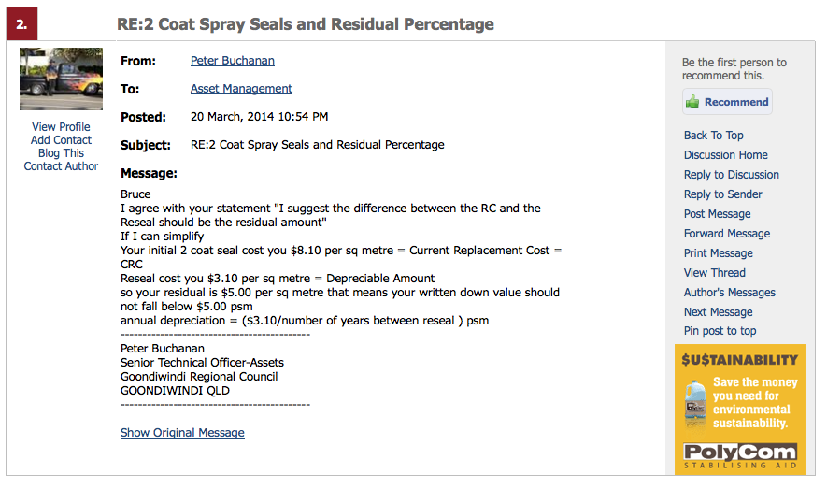
Opened new digital revenue options

Slide 45
User & IPWEA generated content is original
content.
content.

Slide 46
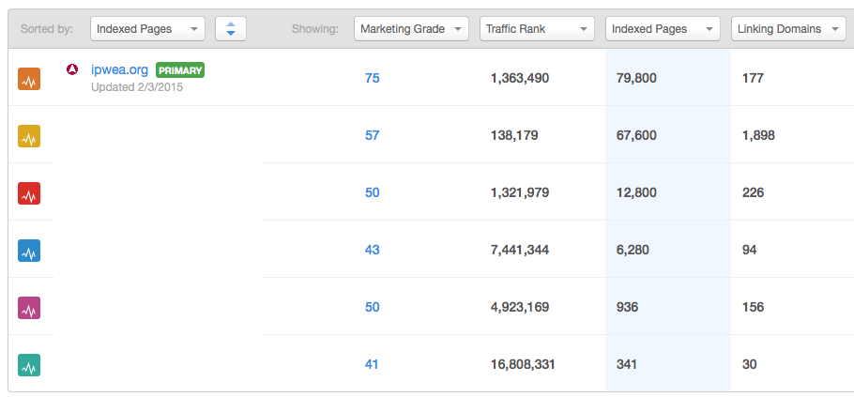
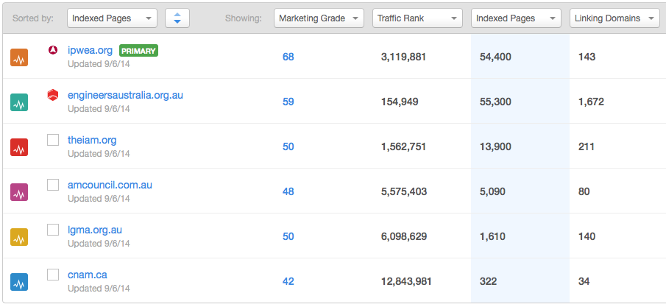
More indexed pages, better ranking

Slide 47
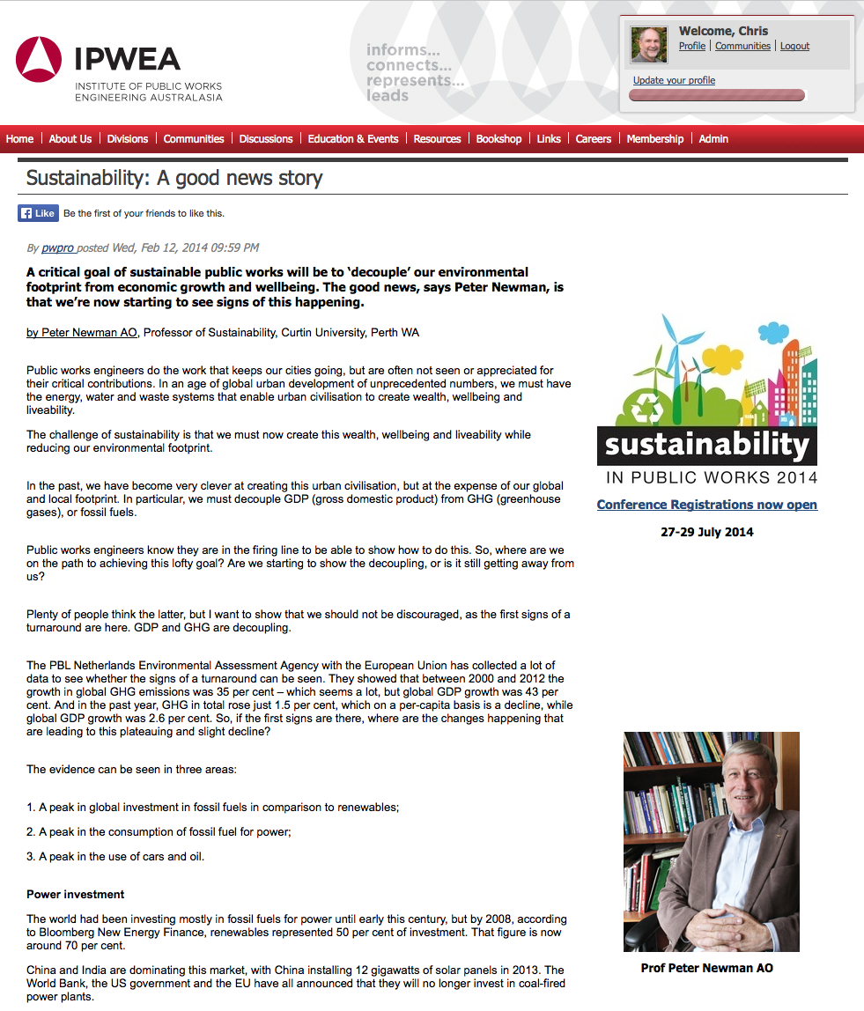
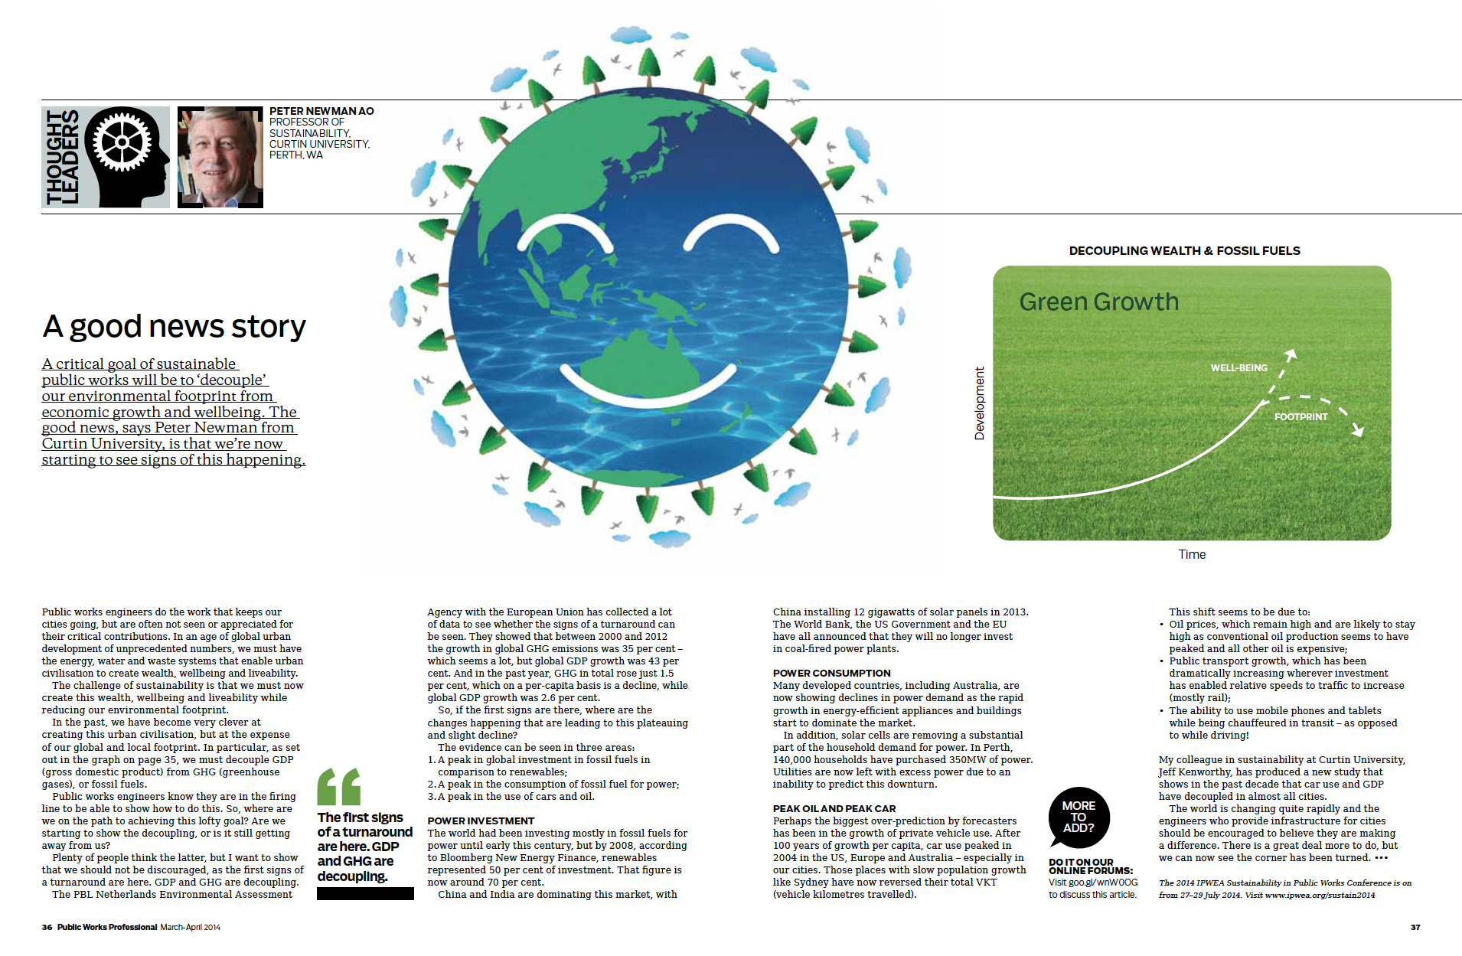
All roads lead to Rome II + all articles lead to website

Slide 48
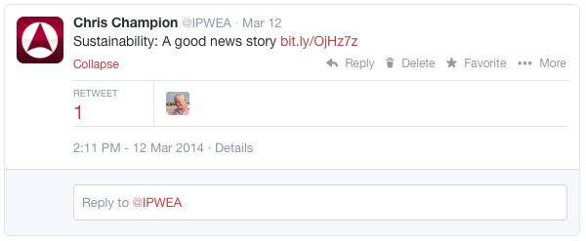
All articles are blogged & tweeted
@IPWEA

Slide 49
Started as a magazine re-launch Segmented eNewsletters opened new opportunities User & IPWEA generated content is original
content.

Slide 50
We have embraced 3 key drivers
integrated systems
integrated content
innovative teams

Slide 51
innovation.
Innovative teams are driving results

Slide 52
New skills from outsourced content publishing
innovation.

Slide 53
Content is guided by IPWEA business goals
Members / Non-Members

Slide 54
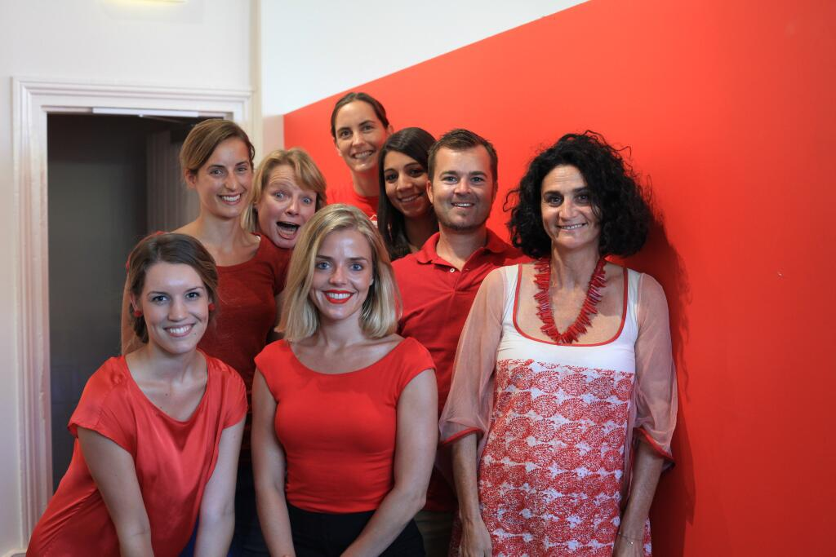
Everyone is of the same mindset (creative; action oriented; passionate)

Slide 55
IPWEA Board appreciates ‘content’ over ‘magazine’
investment in content
-----------------------------
magazine expense

Slide 56
CEO is committed to technology as our edge
innovation.

Slide 57
Larger orgs would be proud our integrated platform

Slide 58
Digital & mobile the future

Slide 59
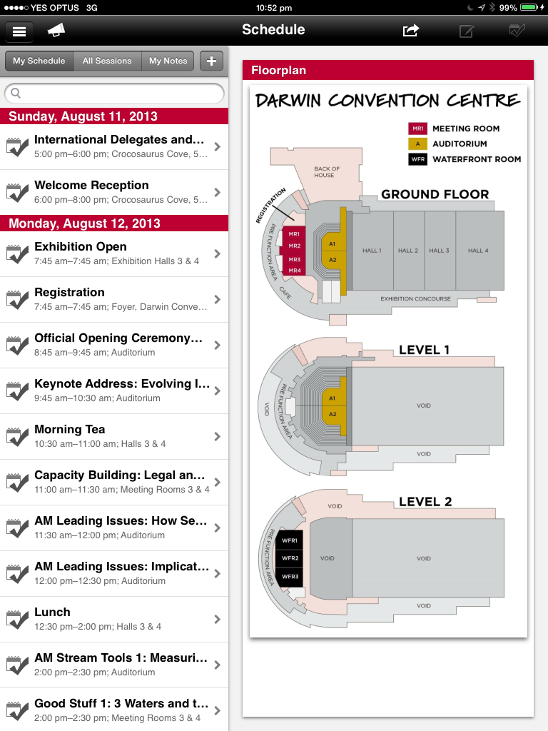
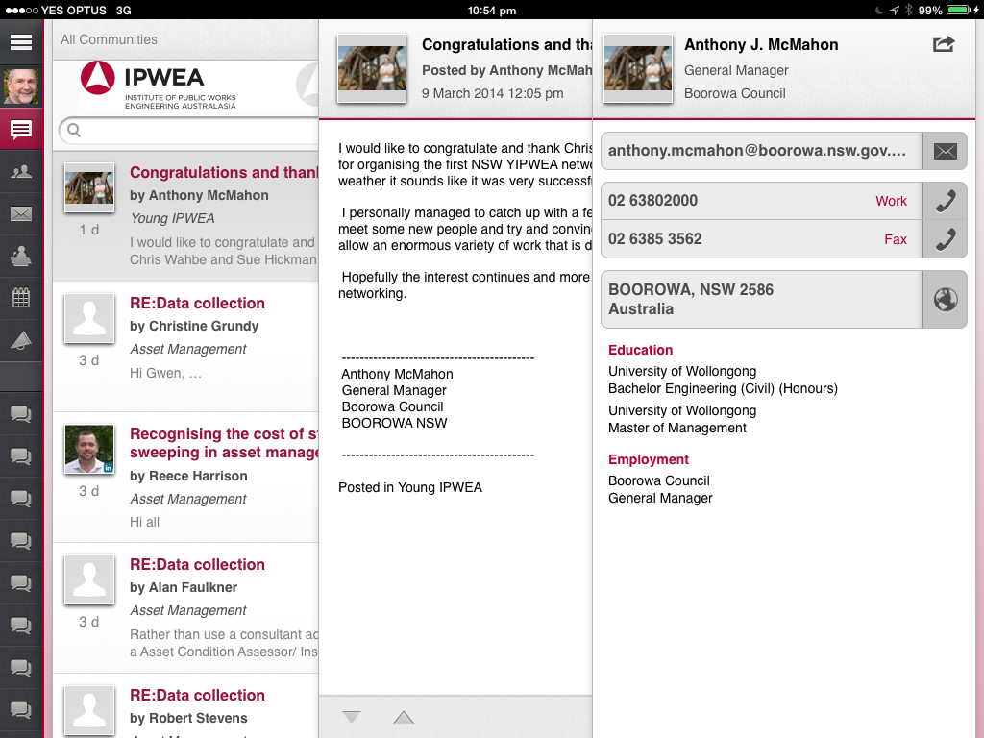
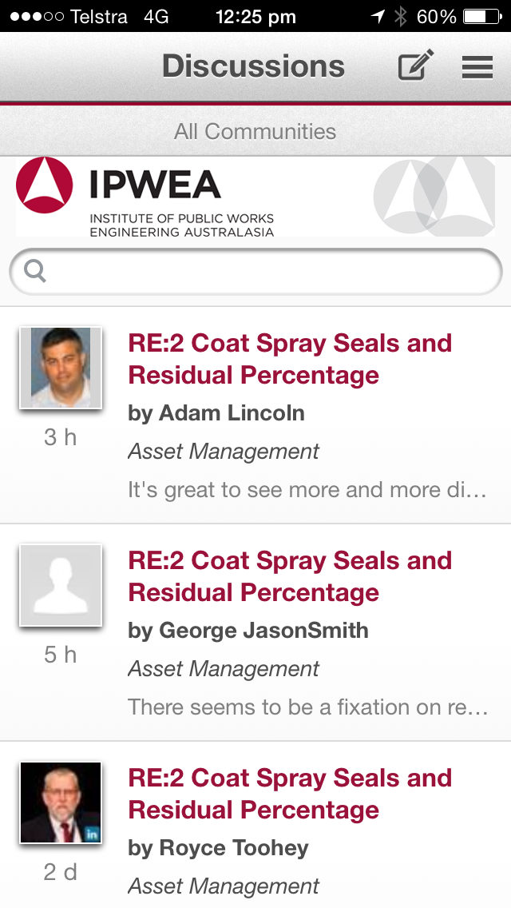
Branded apps & mobile website ready

Slide 60
Innovation & action creates a real buzz
innovation.

Slide 61
Achieving builds real job satisfaction

Slide 62
No risk, then no rewards
<
calculated

Slide 63
Growth is building small teams for succession

Slide 64
How do you deliver for your organisation?
?

Slide 65
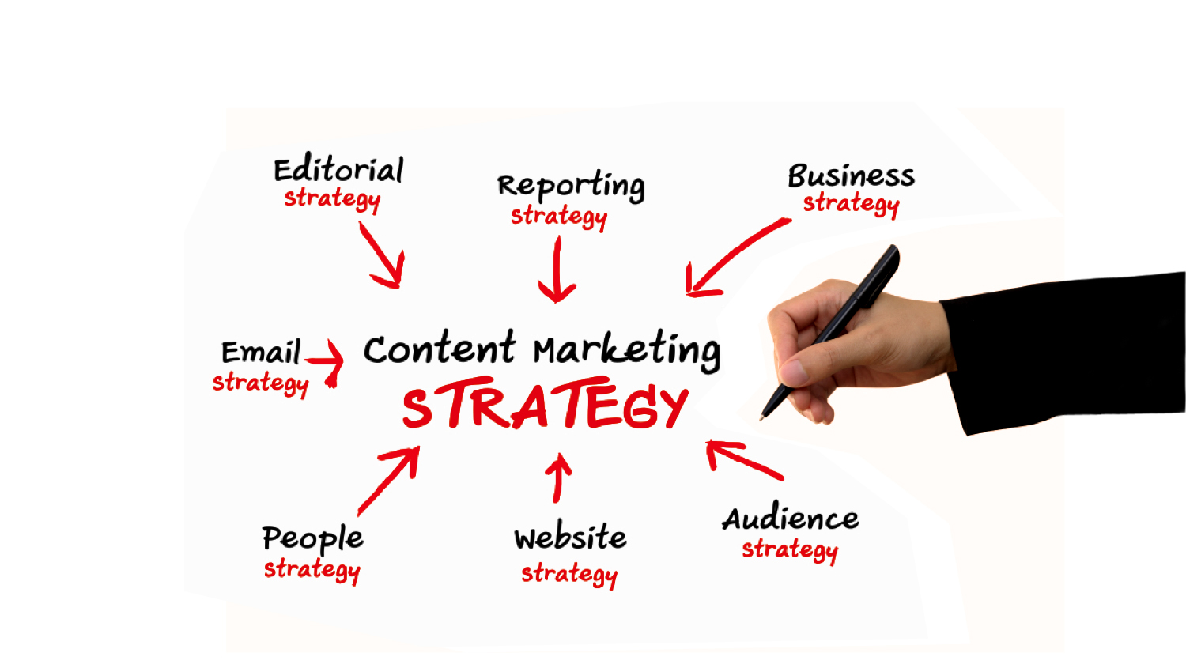
Strategy is key to (content) marketing

Slide 66
innovation.
systems.
content.

Slide 67
A robust contact database was the start Private online communities a key decision Integrated email marketing was the foundation cap
systems.

Slide 68
Started as a magazine re-launch Segmented eNewsletters opened new opportunities User & IPWEA generated content is original
content.

Slide 69
New skills from outsourced content publishing CEO is committed to technology as our edge Innovation & action creates a real buzz
innovation.

Slide 70
Embrace 3 key drivers to leverage outcomes
integrated systems
integrated content
innovative teams

Slide 71
Using Technology as Drivers for Growth & Engagement
Chris Champion
Secretary General International Federation of Municipal Engineering
sec-gen@ifmeworld.org

Slide 72
Roundtable Exercise
List technology systems that your association uses
What are the barriers to implementing improvements?
How can we overcome these barriers?

Slide 73
Systems in your association using technology
Contact Database
Integrated systems
Event registration
Membership subscriptions
Publications purchasing
Convert to eBooks
Social Media
Online communities
Mobile App
Integrated accounts
Online learning
Online joining
Donations system
Email Marketing

Slide 74
Barriers to Implementation
Lack of Chief Executive / Board Support
Lack of resources, funds
Lack of IT skills, experience
Good software systems

Slide 75
How to overcome barriers?
Awareness of importance of technology
An in-house technology champion
Make a start
Involve young members
Cloud solutions
Recruitment strategies
Start online forum
Start online blogs
Can you afford not to implement strategies?

Slide 76
Embrace 3 key drivers to leverage outcomes
integrated systems
integrated content
innovative teams

Slide 77
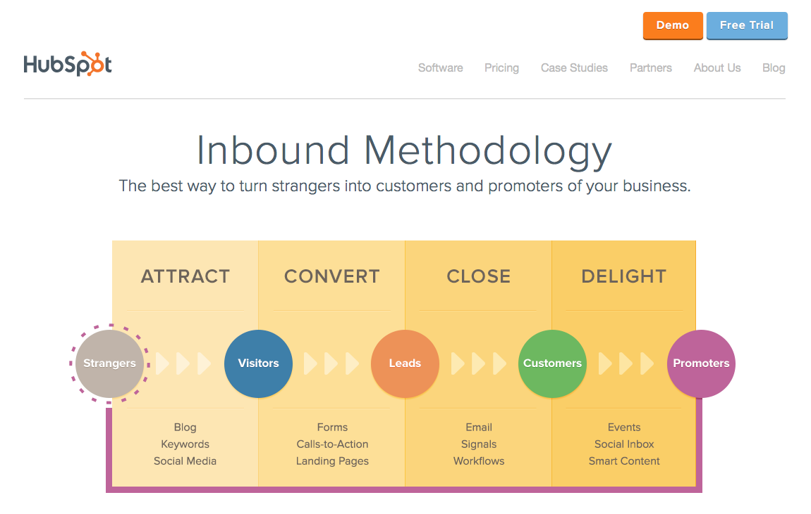
What’s in the pipeline?

Slide 78
Embrace 3 key drivers to leverage outcomes
+ 4 Personalised direct marketing
integrated systems
integrated content
innovative teams

Slide 79
4. Personalized direct marketing
Growing our LinkedIn Group
600 > 2,300
Opening funnel to expand reach
Introduces global opportunities
Segmenting & personalizing
simple messages

Slide 80
Embrace 3 key drivers to leverage outcomes
+ 4 Personalised direct marketing
integrated systems
+ 5 Online learning
integrated content
innovative teams

Slide 82
Embrace 3 key drivers to leverage outcomes
+ 4 Personalised Direct Marketing
integrated systems
+ 5 Online Learning
integrated content
+ 6 Online Joining
innovative teams

Slide 84
Embrace 3 key drivers to leverage outcomes
+ 4 Personalised Direct Marketing
integrated systems
+ 5 Online Learning
integrated content
+ 6 Online Joining
innovative teams

Slide 85
Achieve your goals and grow your organisation

Slide 86
Deliver to your key audience & stakeholders

Slide 87
Using Technology as Drivers for Growth & Engagement
Chris Champion
Secretary General International Federation of Municipal Engineering
sec-gen@ifmeworld.org

