Slide 1
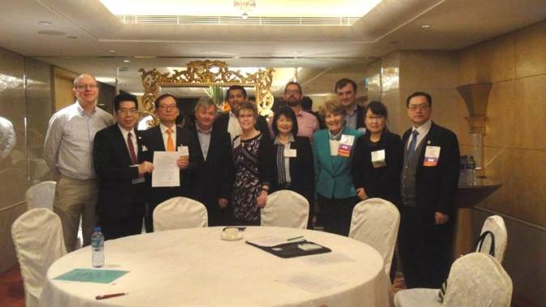
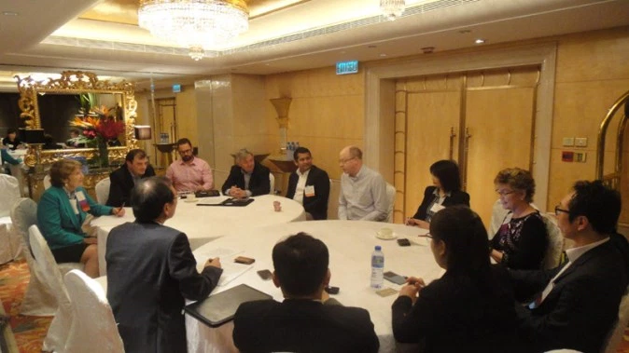
The Hong Kong Charter

Slide 2


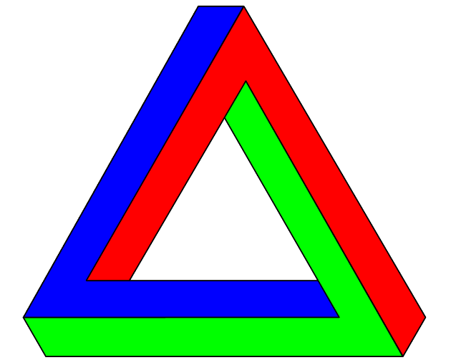

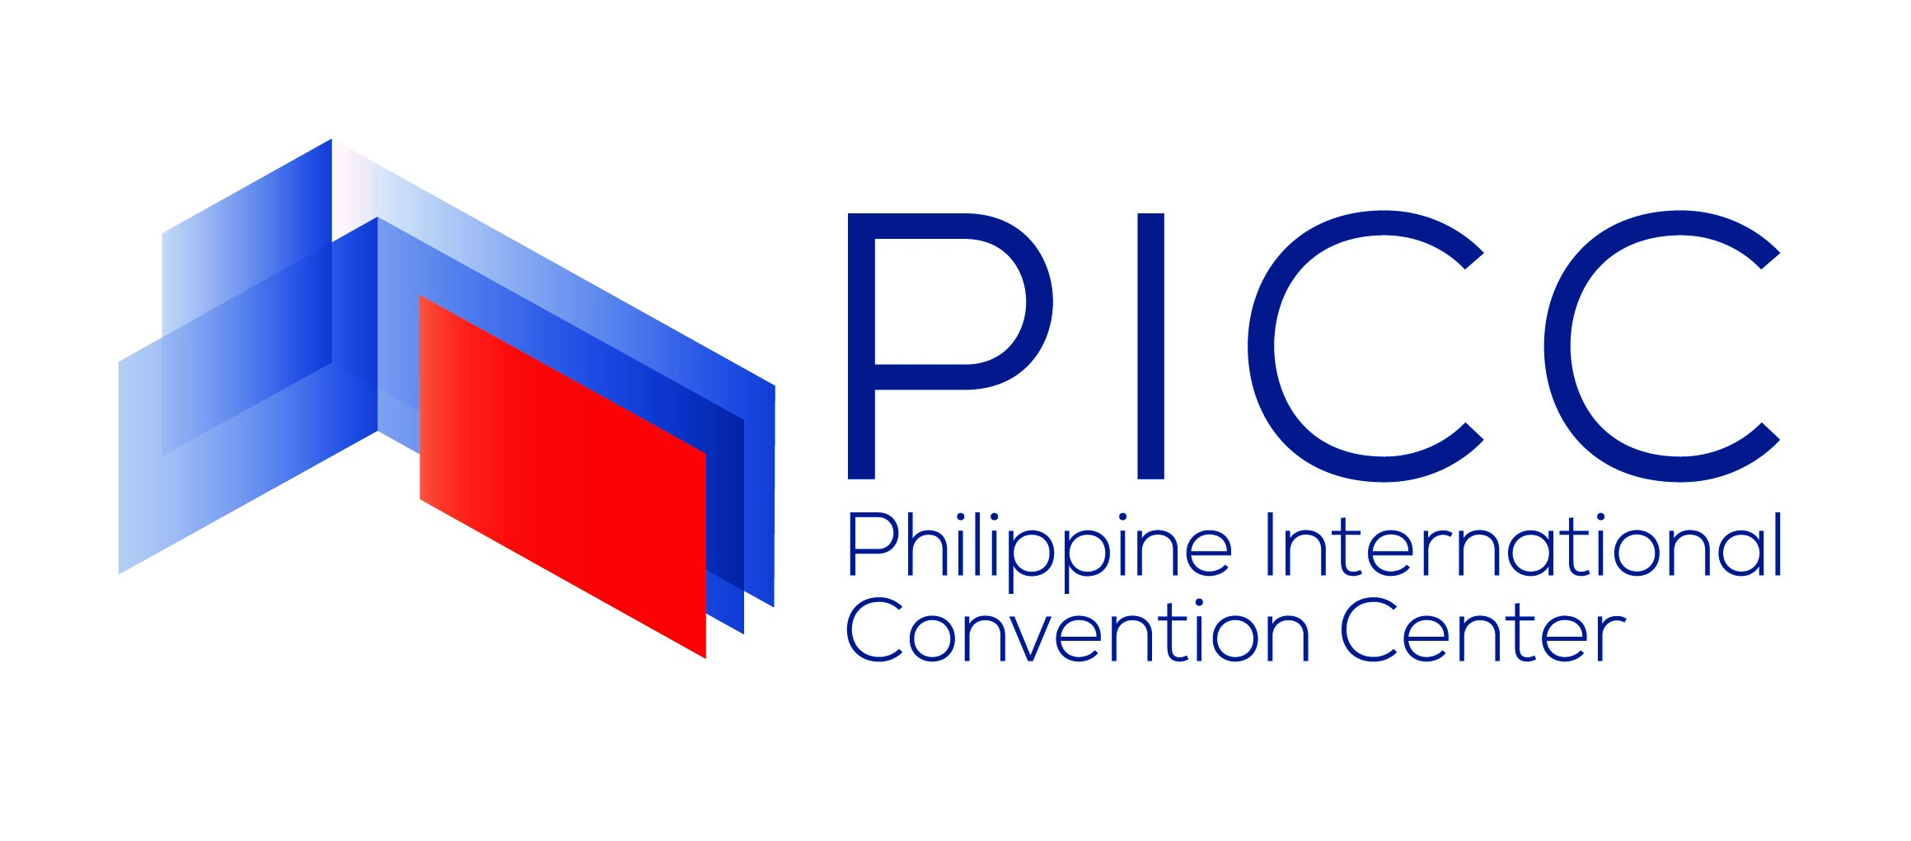
‘Triangle Model’
Boost tourism
through associations by bringing in more MICE events to the country
Attract more associations to hold events at its facility
Enhance association governance & management in Asia-Pacific

Slide 3

3 R’s in Association-building
ELEVANCE
ELATIONSHIP
ESOURCES

