Slide 1
UIA Associations Round Table – Europe 2014 Dublin, 13-14 November 2014
Achieving impact and finding the funds
Dr Dragana Avramov
PSPC, Brussels

Slide 2
Altruism: non-profit organizations (NPOs) and the role of science
Mapping altruism – 125.000 websites of NPOs (Klavans, R. &K.W. Boyak, 2014)
Societal value of (SSH) research and innovation
Fundamental missions are to benefit others and promote societal value

Slide 3
Knowledge based policies
As science and technology are seen as driving forces of modern society and shape many aspects of public and personal lives, they often do so in a complex and unpredictable way (Anthony van Raan, 2000).
Shift in policy making from predominantly ideological premises of societal value of research questions toward a more knowledge-based approach to research questions which address important societal issues and take on board end user needs (e.g. The Swedish Research Council, 2014).
Importance of non-academic and non-formalized knowledge that comes from relevant societal actors (e.g. HORIZON2020)

Slide 4
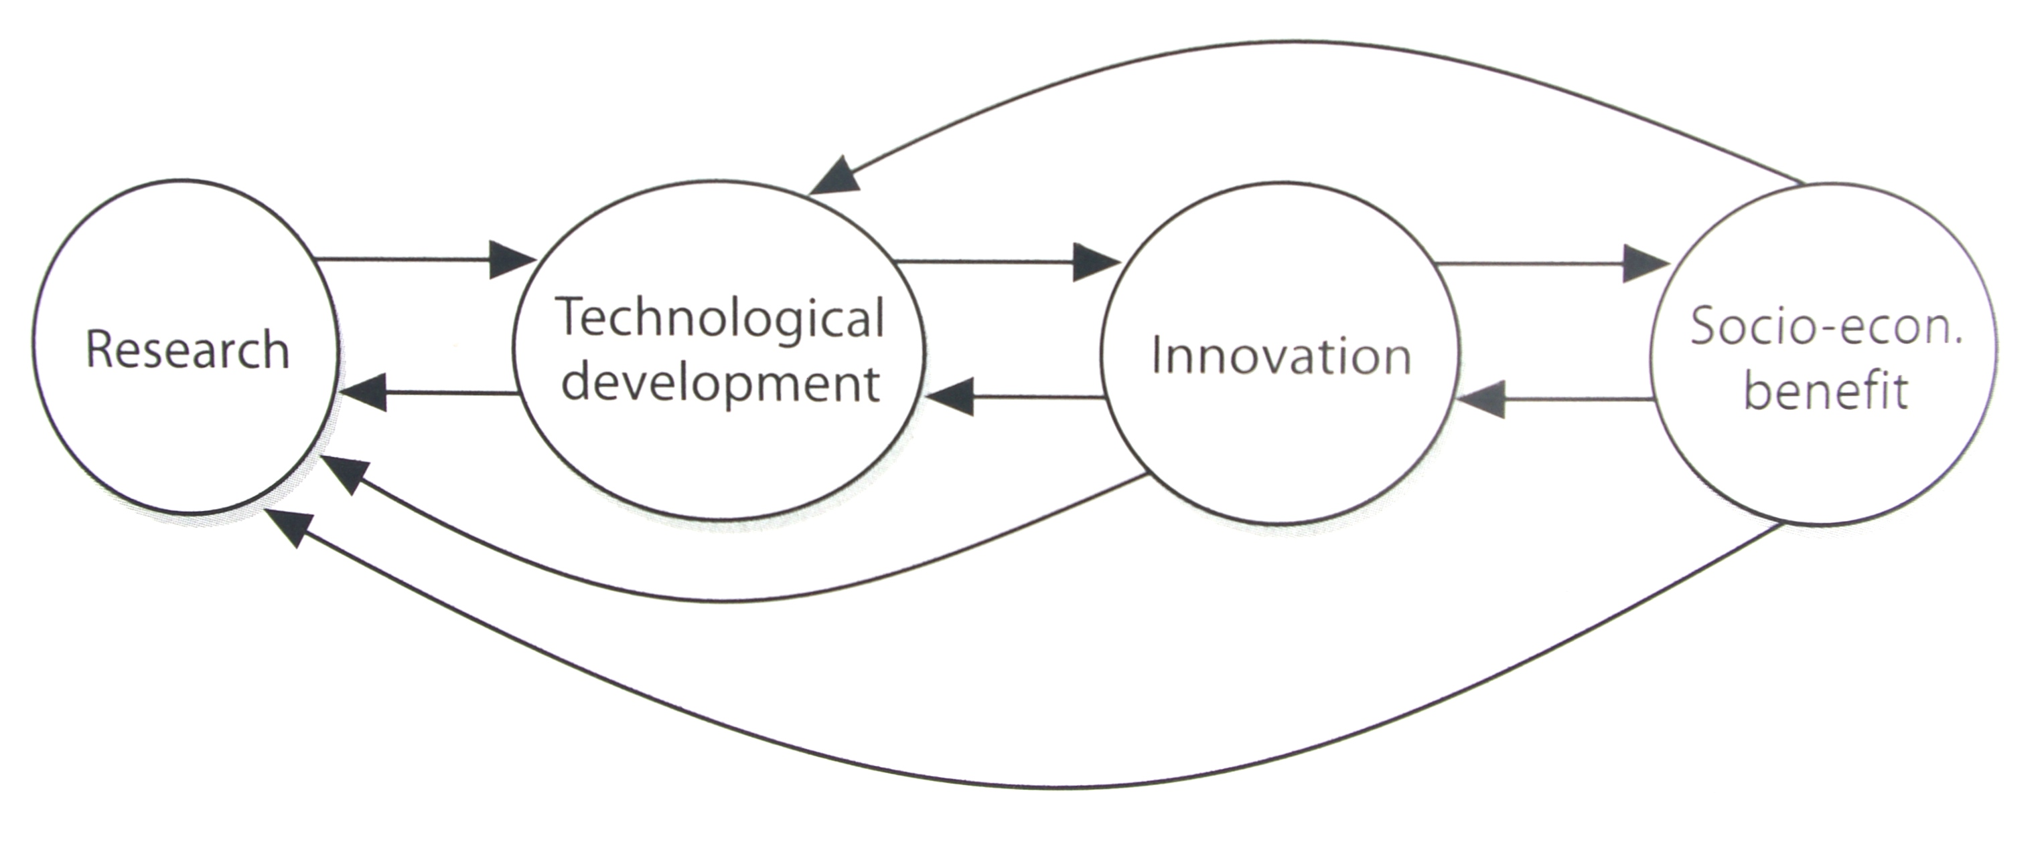
Technology driven concept of societal value Chain link model RDI Impact (Martin 2007; Klein and Rosenberg, 1986)

Slide 5
Responsible Research and Innovation
Researchers, citizens, policy makers, business, third sector organizations…. Work together during the whole research and innovation process in order to better align both the process and its outcomes with the values, needs and expectations of society (HORIZON 2020)

Slide 6
The value chain
ASPECTS
Economic
Environmental
Societal
Cultural
SOCIAL BENEFITS
For individuals
Population sub-groups
Communities
DIMENSIONS
Material/living conditions, health, education, working conditions, social relations, security, socio-political voice, environment, subjective satisfaction

Slide 7
Evaluating the impact and outcomes of European SSH (IMPACT-EV project)
Scientific/technical impact (publications, training, social innovation);
Policy impact (contributing to the implementation of EU directives or recommendations, national, regional and local policies);
Social impact (research evidence in relation to the EU targets such as health, employment, education and social integration).
IMPACT IN HORIZON 2020
Pathways for achieving societal impact of research and innovation (SSH – relevant topics; cross-cutting issues in H2020, in particular trans-disciplinarity)
Notes:
The concept of Service Innovation was first discussed in Miles (1993) [1] and has been developed in the past 2 decades. It is used to refer to many things. These include but not limited to:
Innovation in services, in service products – new or improved service products (commodities or public services). Often this is contrasted with “technological innovation”, though service products can have technological elements. This sense of service innovation is closely related to Service design and "new service development".
Innovation in service processes – new or improved ways of designing and producing services. This may include innovation in service delivery systems, though often this will be regarded instead as a service product innovation. Innovation of this sort may be technological, technique- or expertise-based,or a matter of work organization (e.g. restructuring work between professionals and paraprofessionals).
Innovation in service firms, organizations, and industries – organizational innovations, as well as service product and process innovations, and the management of innovation processes, within service organizations.
Service Innovation is hard to define, one of the many helpful definitions [2] comes from Finland’s research agency, TEKES:[3]
“
Service innovation is a new or significantly improved service concept that is taken into practice. It can be for example a new customer interaction channel, a distribution system or a technological concept or a combination of them. A service innovation always includes replicable elements that can be identified and systematically reproduced in other cases or environments. The replicable element can be the service outcome or the service process as such or a part of them. A service innovation benefits both the service producer and customers and it improves its developer’s competitive edge. A service innovation is a service product or service process that is based on some technology or systematic method. In services however, the innovation does not necessarily relate to the novelty of the technology itself but the innovation often lies in the non-technological areas. Service innovations can for instance be new solutions in the customer interface, new distribution methods, novel application of technology in the service process, new forms of operation with the supply chain or new ways to organize and manage services”.

Slide 8
HORIZON 2020 trans-disciplinary research in grand societal challenges
The evaluation criterion ‘Excellence’ refers to “trans-disciplinary considerations, where relevant”
Trans-disciplinarity refers to approaches and methodologies that integrate as necessary (a) theories, concepts, knowledge, data, and techniques from two or more disciplines, and (b) non-academic and non-formalized knowledge.
In that way, trans-disciplinarity contributes to advancing fundamental understanding or solving complex problems while fostering multi-actor engagement in the research and innovation process.
Guidance for evaluators of Horizon 2020 proposals (Version 1.1 of 16 September 2014)

Slide 9
Public engagement in research
Iterative and participatory multi-actor dialogues
Co-creation of innovative outcomes and policy agendas
Space for ethical value-laden issues to be explored

Slide 10
Participatory methodologies
Approach: Co-production of new knowledge based on:
exchange of background knowledge and experience
learning from others, and drawing on the knowledge of the participants for capturing the key insights
the experience that the participants bring is valorized through sharing of insights and dialogue

Slide 11
Where are opportunities for funding?
Communication of research results and engaging stakeholders
COST - increasing the impact of research on policy makers, regulatory bodies and national decision makers as well as the private sector.
Horizon2020 Coordination and Support Action (under various societal challenges)
Horizon2020 Science with and for Society

Slide 12
Know your strengths and reach out to research community
Raise awareness of the association and the relevance of the activities and topic addressed (let others know what you are doing and why it is important)
Inform – provide the knowledge base to the communities you are addressing
Engage – get input/feedback from those communities
Promote –outputs and findings and involve stakeholders as multipliers and policy makers

