Slide 1
Building Membership Value through Connections and Engagement

Slide 2
Reginald J. Henry, CAE (Reggie)
Phone: (202) 326-9547
Email: reggie@asaecenter.org
Web Site: http://www.asaecenter.org
Twitter: @ReggieHenry

Slide 3
Why is Member Engagement Important?
Involved members don’t drop out
Meaningful connections and experiences for your members will keep them coming back
It costs five to six times more to recruit a new member than it does to keep an existing one
From 199 Ideas: Member Service and Engagement, published by ASAE (2011)
Notes:
From: 199 Ideas: Member Service and Engagement, published by ASAE (2011)

Slide 4
What is Engagement?
Member engagement is the result of a member investing time and/or money with the association in exchange for value. The more of these precious resources they invest, the more engaged they are.

Slide 5
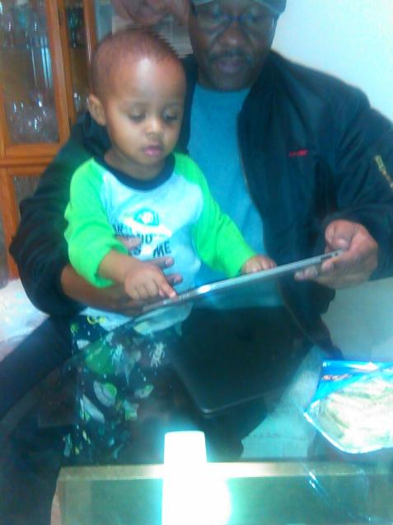
“any sufficiently advanced technology is indistinguishable from magic.”
Sir Arthur Charles Clarke
co-writer of the screenplay for the movie 2001: A Space Odyssey
NEWS FLASH!!
We now have sufficiently advanced technology

Slide 6
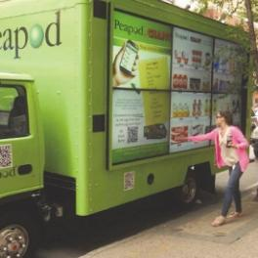
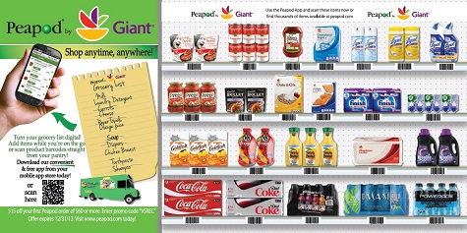
a "real" food truck!
We now have sufficiently advanced technology
Notes:
So what does technology magic look like?

Slide 7
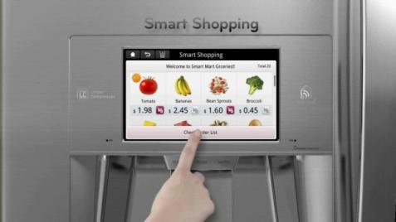
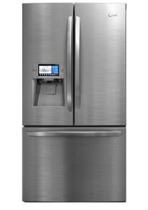
a really "smart" refrigerator
We now have sufficiently advanced technology

Slide 8
©NAIOP 2013
Notes:
The amount of fundamental change to our basic understanding of what “computing” means, how “computing” happens, and who and what drives innovation in that space, is staggering. In fact, I've seen more significant technology change in the last 5 years, than in the previous 20 years. It demands a shift, a significant shift, in how we think about technology today. Examples – mobile, social networking, location awareness, cloud computing, etc.

Slide 9
What is Member Engagement?
Member engagement is the result of a member investing time and/or money with the association in exchange for value. The more of these precious resources they invest, the more engaged they are.
David Gammel, Executive Director
Entomological Society of America

Slide 10
Value is Different for Different Members

Slide 11
Value is Different for Different Members
They don't all want the same apple....
...in fact, they might not even want apples!

Slide 12
Membership Value
The number one reason individuals or companies join an association is because they believe the association will help them solve a problem
The End of Membership as We Know It: Building the Fortune-Flipping, Must-Have Association of the Next Century by Sarah L. Sladek, Published by ASAE (2011)
Notes:
This is a very "right now" kind of proposition. It doesn't necessarily speak to waiting for the Annual Meeting, or reading a book, or wait for the next Journal to come out.
What is does speak to is having resources quantified and organized in a way that members can find them. Easily. Quickly. Based on their needs.

Slide 13
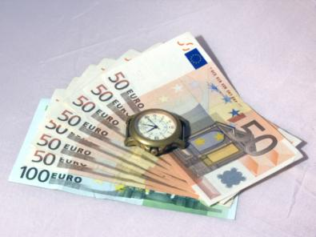
Membership Value
Define value:
Members decide what has value
Value is validated by a member’s willingness to exchange money or time for something
Value is different for different members
From Road to Relevance: 5 Strategies for Competitive Associations,
by Harrison Coerver and Mary Byers, CAE, Published by ASAE (2013)
Notes:
From: Road to Relevance: 5 Strategies for Competitive Associations, by Harrison Coerver and Mary Byers, CAE Published by ASAE (2013)

Slide 14
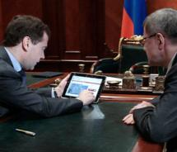
How do members access value?

Slide 15
Challenges to Engagement Today
Members having time to participate
Getting to know members at a deeper level
Getting their Attention: Communicating in an appropriate way - on their terms
Keeping member’s interest through continuous engagement

Slide 16
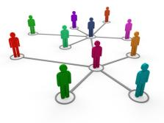
Your Organization's Many Resources
Books
Meetings
Discussions
Journals
People
Notes:
Traditionally, associations have created value through their resources. We now have to consider non-traditional resources as value! Use the Jeff Cufade story as an example.

Slide 17
Your Organization's Many Resources
So the question is....
...How do we connect our members to all of the organization's resources?
in a way that creates value for them?
Notes:
This isn't just a website problem! Your organization has many resources that can't be rendered via the website.
This is a much bigger problem than that.

Slide 18
So where do we start?

Slide 19
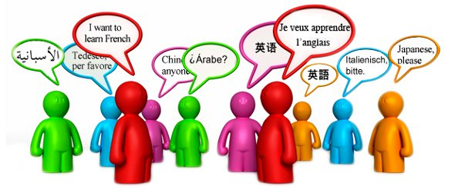
We need a common language!
One that both we and our members can use...

Slide 20
We need a common language!
.... a language that can be used for classifying our resources, and to describe our members needs and interests!
We need a Taxonomy!

Slide 21
What is a Taxonomy?
Let's Keep it Simple
A hierarchical classification or categorization system…in reference to any means of organizing content.
Notes:
This taxonomy has to be ubiquitous in your organization. In every system you use, content or otherwise, it has to be there.

Slide 22
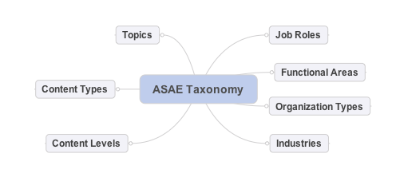
The ASAE taxonomy has 7 branches (or facets)
Let's go see!

Slide 23
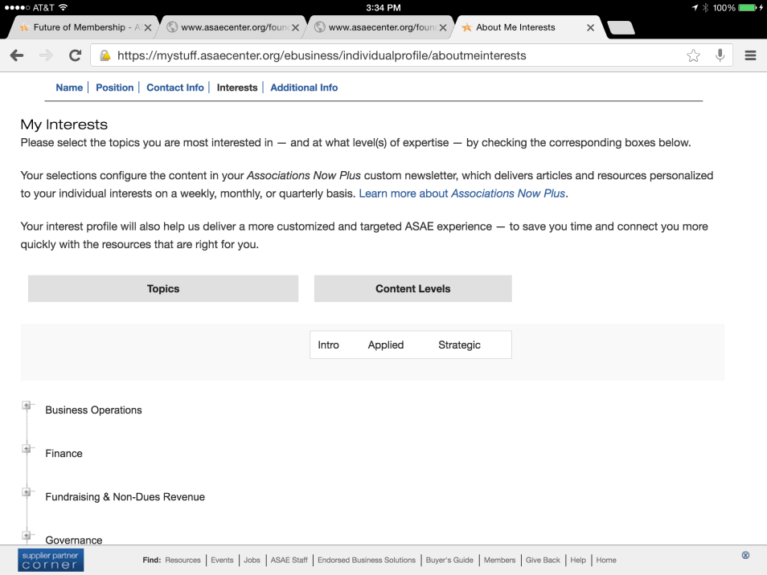
Let's go see!
Notes:
What if we also had a way for member to tell us what they are working on right now! Not interests, but need!!!! Using the same taxonomy!!!!

Slide 24
Don't Guess...KNOW!

Slide 25
How the Taxonomy is Used
Connecting Members to Content

Slide 26
Rethink Content Strategy
You must have a taxonomy! It is the common language that's used to categorize your resources and by which your members indicate their interests/needs. The taxonomy must be present in every digital system you have. Period!

Slide 27
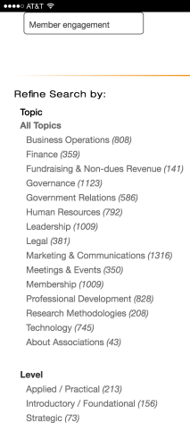
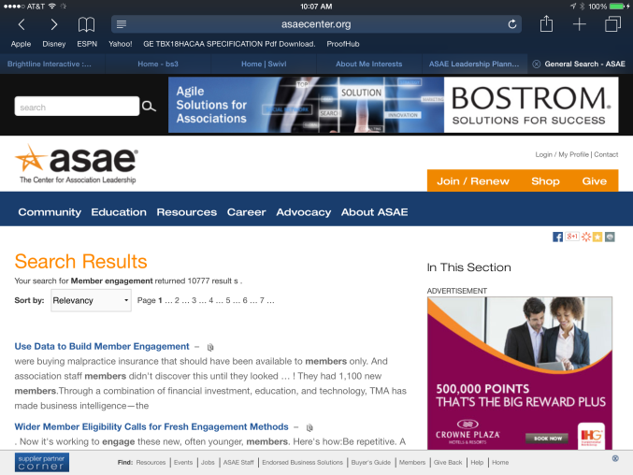
How the Taxonomy is Used
Refining search results on websites

Slide 28
Or even better, don't make them work so hard...how about just sending them what they say they are interested in!

Slide 29
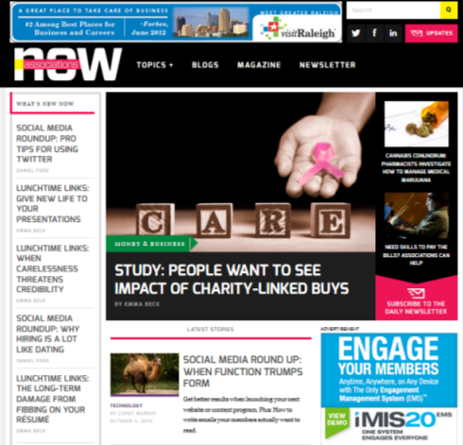
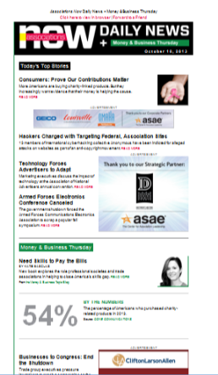
How the Taxonomy is Used
General Content
Personalized Content
Notes:
Talk about the member who called and realized that e taxonomy allowed them to control their own content experience.

Slide 30
Rethink Content Strategy
You must have a taxonomy! It is the common language that's used to categorize your resources and by which your members indicate their interests/needs. The taxonomy must be present in every digital system you have. Period!
In the future, most organizations will have multiple websites or other types of content repositories. Most likely they will have multiple content management systems. You've got to find a way to mitigate content silos!

Slide 31
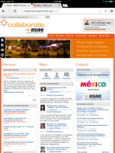
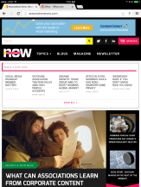
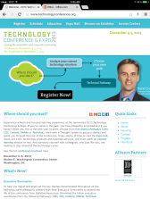
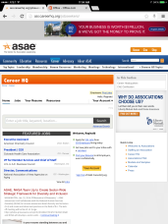
"Middleware"
Solution?
Create a process that indexes content from all sites.
Content from anywhere becomes available everywhere!
While we're at it, rethink our search experience

Slide 32
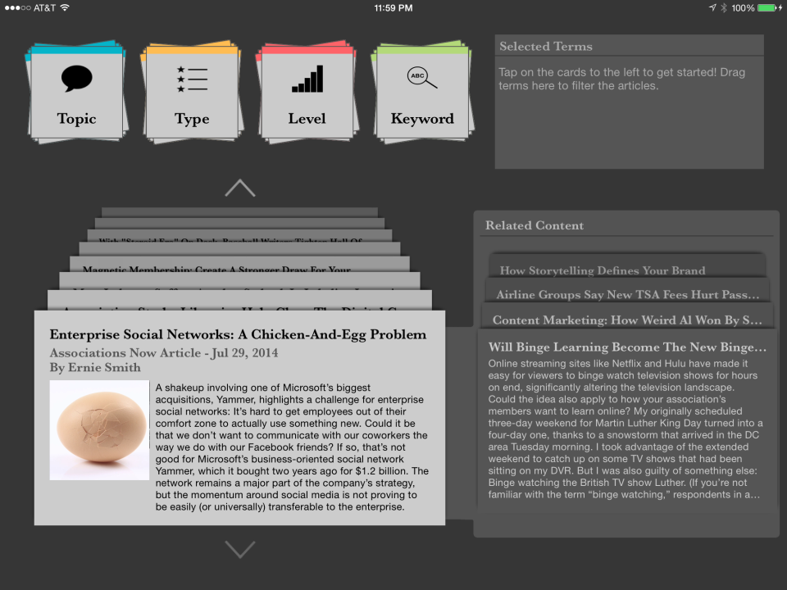
Let's go see!

Slide 33
Rethink Content Strategy
You must have a taxonomy! It is the common language that's used to categorize your resources and by which your members indicate their interests/needs. The taxonomy must be present in every digital system you have. Period!
In the future, most organizations will have multiple websites or other types of content repositories. Most likely they will have multiple content management systems. You've got to find a way to mitigate content silos!
It's not about search and find anymore, it's more about know and deliver.

Slide 34
How the Taxonomy is Used
Don't just tag traditional content, tag everything!

Slide 35
Consider Connected Content
Connected Content
What if I land here and it’s too complicated?
What if its WAYYYY too complicated?
What’s it about?
Who wrote it?
When was it written?
What’s the source?
What if I land here and and I need deeper information?

Slide 36
Consider Connected Content
Unorganized Content
“How do I” linked content?
Write a marketing plan
Step 1. ________________________
Step 2. ________________________
Step 3. ________________________
Step 4. ________________________
Content organized by most common projects
Notes:
This is a level deeper than most of use think about our content and/or our members needs. Curation of this content makes it easier for your members to "solve their problems"

Slide 37
Content Curators:
Be Their Trusted Source of Content
Build Their Trust
Be a curator of content
Help them through the Clutter
Give them the vetted solutions – and best practices
Notes:
ASAE example of our Resource Center where we used to send out several pages of resources
What they want it the best solution; the vetted solution
They want us to go through the clutter and provide the best information or tool for their problem
That can sometimes be a real

Slide 38
Engagement
Connecting Members to Members

Slide 39
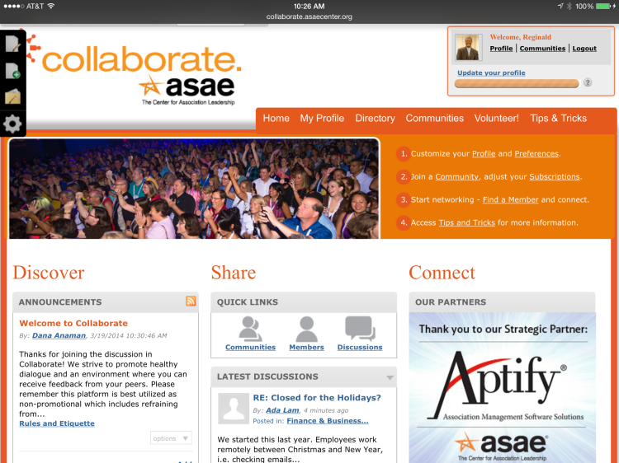
Consider a Private Social Network
Let's go see!
Notes:
Talk about CEO engagement
Talk about the town hall concept
Talk about work place for formal groups
Talk about self starting and ending groups

Slide 40
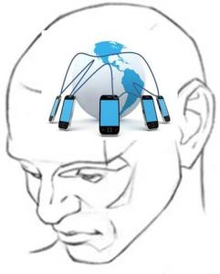
Develop a Mobile Mindset!
Think Mobile First!!

Slide 41
Mobile First = User Needs First!
It’s, ultimately, a re-imagining of how our content fits our users needs. Just think about what Mobile First really implies. “What tasks make sense to the user?” “What does the user want?” “What is going to be most relatable to the user?” All of these things are focused on the personal nature of the experience.
Jason Grigsby, Vice President, Mobile and Web Strategist
Cloud Four, Inc.

Slide 42
The Mobile Mindset
Mobile USAGE is Different!
Think
Presence at the Point of Need!

Slide 43
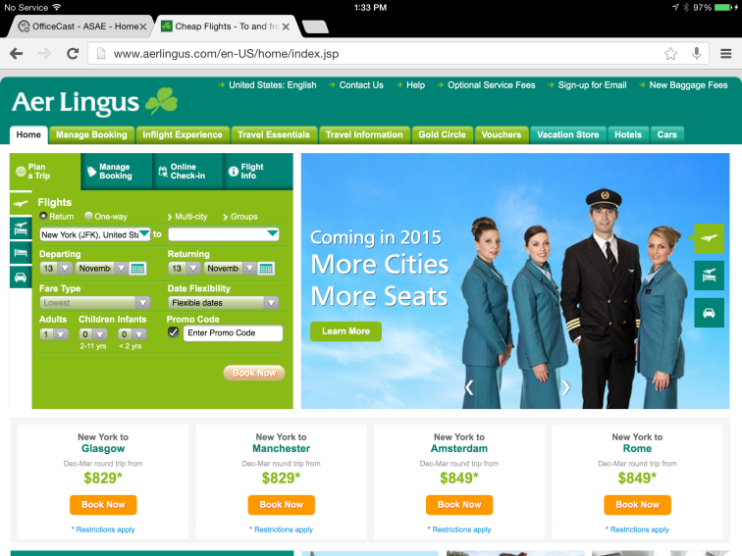
The Mobile Mindset
Extraneous

Slide 44
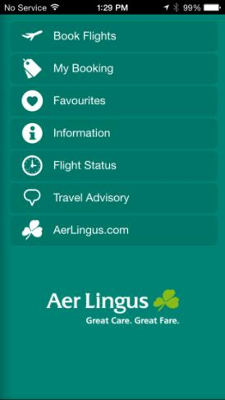
The Mobile Mindset
When designing for mobile, consider the “mobile context”. Where will the user most likely be, what might they be doing, how long will they most likely have, etc.

Slide 45
Engagement
Connecting Members to Events

Slide 46
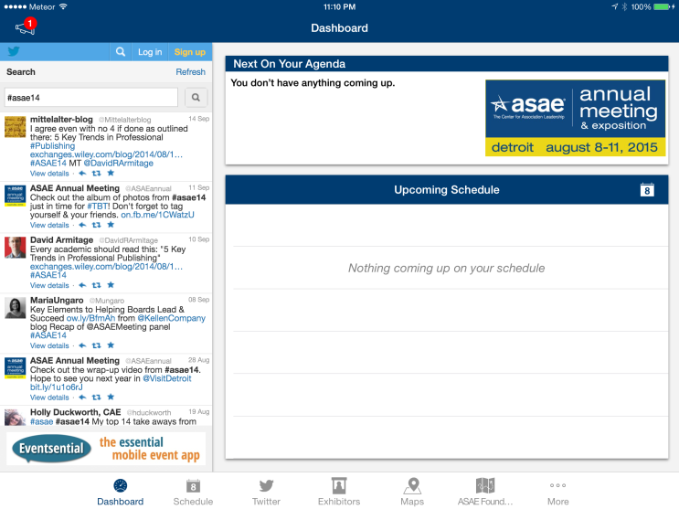
Connecting Members to Events
Let's go see!

Slide 47
closing thoughts
Engagement is when members invest time and/or money with the association in exchange for value
Membership in Context: Providing Value to Members Where They Are
We must create environments where members can manage their acquisition of value, on their terms
Increasingly, member access to value is digital and mobile, technology has a huge role to play. Digitize everything and think mobile first!

Slide 48
think digital ecosystem

