Slide 1
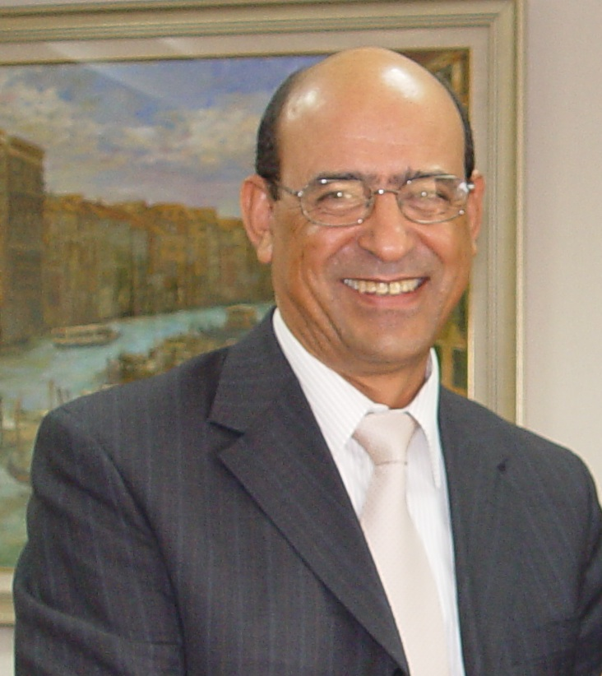
HOW IEEE* IS ORGANIZING CONFERENCES WORLWIDE
MONACO 2016
UIA ASSOCIATIONS MEETING
MONACO, 3-4 NOVEMBER 2016
Professor Amara AMARA
IEEE CASS Vice-President for Conferences
IEEE France Section Chair
* Institute of Electrical and Electronics Engineers
UIA ASSOCIATIONS

Slide 2

About me
MONACO 2016
Current Position: Deputy Managing Director of ISEP (Paris) in charge of Research and International Development,
My wife is also holding a PhD and is designing chips for pacemakers and defibrillators,
My daughter is Doctor in dentistry and is pursuing with a specialty in the field,
My research interest can be summarized by 4 words: « Technology Assessment for Green Electronics »,
IEEE France Section Chair January 2014 to December 2016,
IEEE CASS BoG member for 5 years (worldwide election) from 2008-2010, 2012-2013 serving in the conference division,
IEEE CASS Vice-President for conferences since 2014 till now,
ISCAS Steering Committee Chair
UIA ASSOCIATIONS
IEEE PROPRIETARY

Slide 3
About my Association: IEEE
MONACO 2016
IEEE (Institute of Electrical and Electronics Engineers):
  Interrnational association with the Headquarter in USA, more than one century of exixtence
  More than 410 000 members (80000 students) in 160 countries,
  38 Technical Societies and 7 Councils,
  More than 1600 Chapters
  324 Sections,
  Publishes 30% of the scientific and technical production worldwide in his field,
  Offers 900 International Standards.
UIA ASSOCIATIONS
IEEE PROPRIETARY

Slide 4
IEEE MISSION & VISION
MONACO 2016
MISSION:
  IEEE fosters technological innovation and excellence for the benefit of humanity.
VISION:
  IEEE will be essential to the global technical community and to technical professionals everywhere, and be universally recognized for the contributions of technology and of technical professionals in improving global conditions.
UIA ASSOCIATIONS
IEEE PROPRIETARY

Slide 5
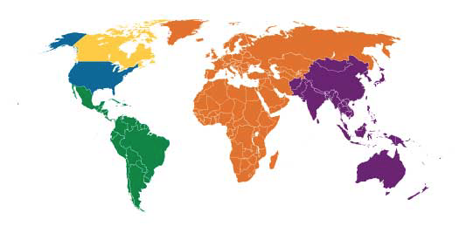
IEEE Membership By Region
MONACO 2016
R7: 16,690
R8: 76,246
R1-6: 191,836
R9: 18,155
R10: 108,929
Almost 412 000 Members
UIA ASSOCIATIONS

Slide 6
IEEE Global Conference Activity
MONACO 2016
To date in 2016 IEEE….
  Is expected to sponsor 1758 conferences* (78% in R7-10)
    YTD 775 financially sponsored approved (64% in R7-10)
    YTD 718 technically co-sponsored approved (92% in R7-10)
  In 91 countries
  Partnering with over 1100 non-IEEE entities
    76% of all IEEE Conferences are co-sponsored
    89% of those are co-sponsored by a non-IEEE entity
  Estimating over 470,000 attendees
    289K financially sponsored conferences
    181K technically sponsored conferences
  As of 31 May 2016, is expected to acquire 1635 conference proceedings*
UIA ASSOCIATIONS
IEEE PROPRIETARY

Slide 7
Total # of IEEE Conferences
IEEE Society/Council/Geographic Unit/Other – Sponsored/Co-Sponsored
MONACO 2016
1635
1331
1394
1489
Conference Activity through 30 September 2016
2016 Totals include a projection for events yet to be registered. This value will likely change in future reports.
UIA ASSOCIATIONS
IEEE PROPRIETARY

Slide 8
2014 vs 2015 Top 10 Locations for All Conferences by Country–*
MONACO 2016
* Approved Conference Activity
UIA ASSOCIATIONS
IEEE PROPRIETARY
Notes:
Annual
Rich Jannuzzi
r.jannuzzi@ieee.org
3/31/16
In 2014, 9 of 10 of the same countries appeared in the top 10 at month end May. Missing this year is Singapore (which appeared in 2013 due to one large event with 37 sub events connected with it). Replacing Singapore in 2014 is the United Kingdom which was number 12 last year..
Emerging countries:
R8 Tunisia 2013(11) 2014(15)
R9 no significant changes, the top 4 each year are below. In 2013 beyond the top 4 all remaining countries only sponsored one each.
2013: Brazil (17) Mexico (7) Colombia (6) Argentina (4)
2013: Brazil (16) Mexico (6) Argentina (5) Colombia (2)

Slide 9
2013 vs 2015 Revenue for All Conferences by Continent–*
* Data as of 31 March 2016
UIA ASSOCIATIONS
IEEE PROPRIETARY
Notes:
Rich Jannuzzi
r.jannuzzi@ieee.org
3/31/16
In 2014, 9 of 10 of the same countries appeared in the top 10 at month end May. Missing this year is Singapore (which appeared in 2013 due to one large event with 37 sub events connected with it). Replacing Singapore in 2014 is the United Kingdom which was number 12 last year..
Emerging countries:
R8 Tunisia 2013(11) 2014(15)
R9 no significant changes, the top 4 each year are below. In 2013 beyond the top 4 all remaining countries only sponsored one each.
2013: Brazil (17) Mexico (7) Colombia (6) Argentina (4)
2013: Brazil (16) Mexico (6) Argentina (5) Colombia (2)

Slide 10
Conference Size by Attendance
IEEE Financially Sponsored/Co-Sponsored Conferences
MONACO 2016
~72% of IEEE Conferences are <300 Attendees
Approved Conference Activity through 31 May 2016
Based on Estimated Attendance
UIA ASSOCIATIONS

Slide 11
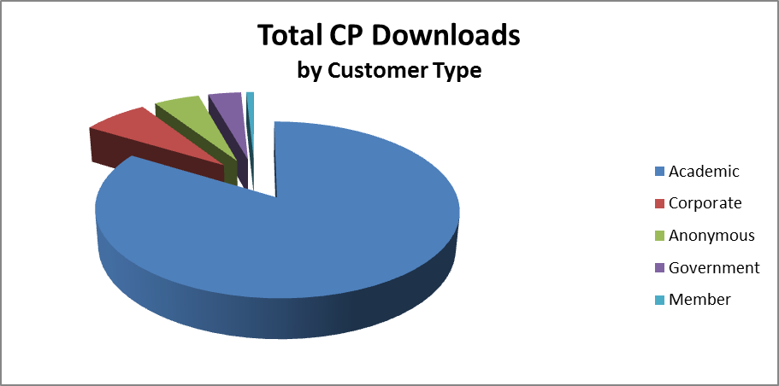
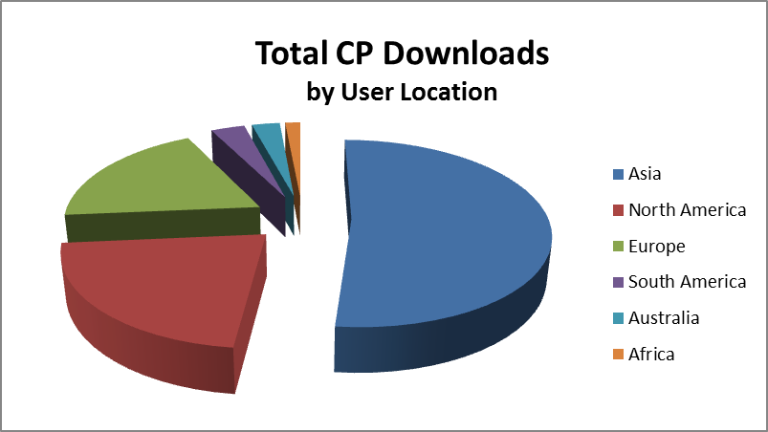
Conference Proceedings Usage
(as of 30-September-2016)
MONACO 2016
UIA ASSOCIATIONS
IEEE PROPRIETARY
Notes:
Rich Jannuzzi
r.jannuzzi@ieee.org
3/31/16

Slide 12
What are the Challenges in organizing IEEE Conferences
MONACO 2016
UIA ASSOCIATIONS
IEEE PROPRIETARY

Slide 13
SPECIFICITY OF IEEE CONFERENCE ORGANIZERS
MONACO 2016
Conferences are organized and leaded by volunteers from Academia or Industry,
UIA ASSOCIATIONS
IEEE PROPRIETARY

Slide 14
Challenge 1
MONACO 2016
Preparing the Bid:
  Outstanding Organizing Committee,
  Outstanding Technical Committee,
  Find an attractive location,
  Find an attractive venue,
  Negotiate different contracts (venue, hotels, Service P…),
  Elaborate a credible and realistic budget,
  Find a friendly and helpful Congress Bureau to work with,
UIA ASSOCIATIONS
IEEE PROPRIETARY

Slide 15

Challenge 2
MONACO 2016
Submit and get sponsorship from IEEE:
  Sponsorship is not automatically granted (yearly MoU or Multiple year MoU),
  Go through an online IEEE procedure (ICX),
  Once approved by IEEE, an MoU is generated and sent to all the sponsoring parties,
  Once the MoU is signed by all parties, the sponsorship is granted.
UIA ASSOCIATIONS
IEEE PROPRIETARY

Slide 16
Challenge 3
MONACO 2016
Organize the conference:
  Recruit a PCO for medium & large conferences
  Define the timeline of the conference,
  Design the Call for papers,
  Define publicity strategies and publicize accordingly,
  Set up the Technical Program,
  Set up Registration Site,
  At each step oversee the budget,
  Address any logistics issues …
UIA ASSOCIATIONS

Slide 17
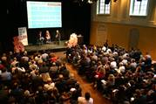

Challenge 4 & 5
MONACO 2016
Save time to enjoy the conference,
Close properly the Conference
  Submit final report,
  Submit final budget,
  Transfer the surplus to the sponsoring parties,
  Close the account used for the conference.
UIA ASSOCIATIONS

Slide 18
How Monaco CVB helped us
MONACO 2016
UIA ASSOCIATIONS
IEEE PROPRIETARY

Slide 19
1- How I had to hear about
Monaco as a conference destination?
MONACO 2016
I organized many events in Paris and was awarded a medal and the Title of Ambassador of city of Paris for organizing ISCAS in 2010 (1400 participants),
I was invited by “Atout France Association” who organized an educational day for associations in Paris on October 2012,
I had the chance to meet Laurence (she was sitting at the same table) who paid a visit to me and invited me to some other events organized by Monaco in Paris,
Then I decided to have a close look to Monaco as a possible destination for my future events.
UIA ASSOCIATIONS
IEEE PROPRIETARY

Slide 20
2-Events organized in Monaco
MONACO 2016
IEEE FTFC on May 2013, Novotel hotel:
  I launched this event in 1997 on Low Voltage and Low Power, the topic started to be very hot at this time, it’s what we call now Green Electronics, around 80 pax,
Board of Director of IEEE Region 8 in March 2016, Fairmont hotel:
  Reached a record of more than 200 participants (usually 150),
  The most important VIPs of IEEE staff attended the meeting: the past President, the current President and the President Elect,
  The meeting was evaluated as the most successful meeting for at least the last 2 decades,
ICECS in December 2016, Grimaldi Forum:
  Registration ongoing,
  We have a very good expectations in terms of quality and participants expectations,
UIA ASSOCIATIONS
IEEE PROPRIETARY

Slide 21
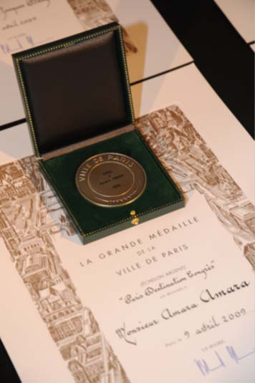
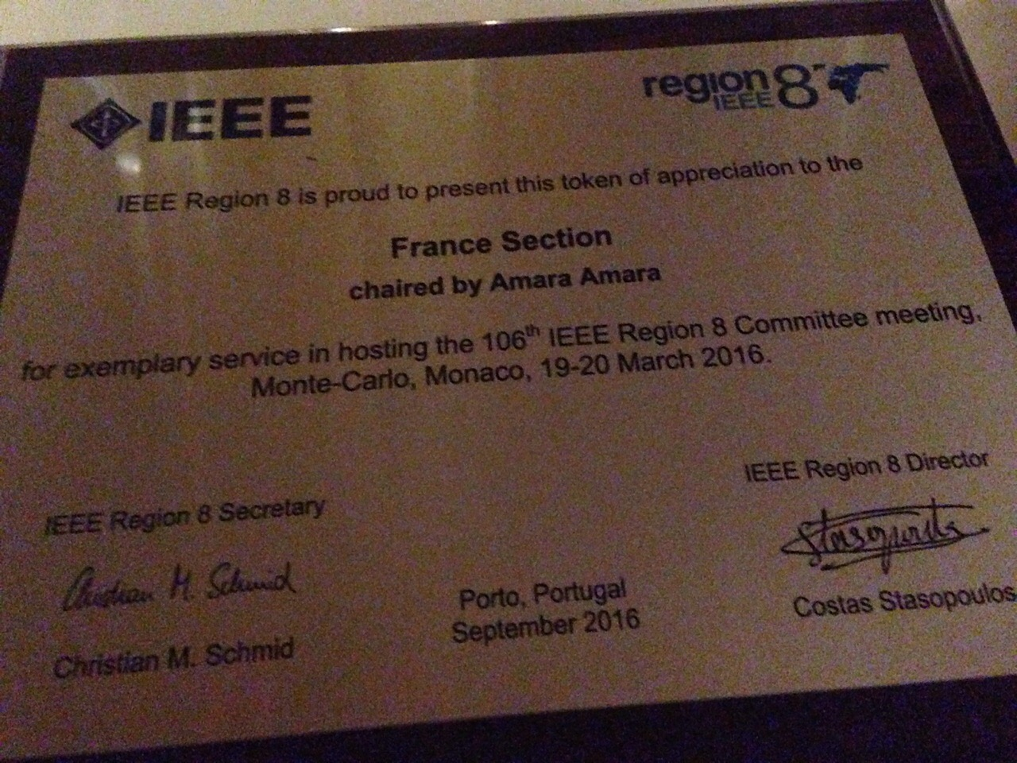
Medals
MONACO 2016
R8 Board of Directors, Monaco
ISCAS 2010 in Paris
UIA ASSOCIATIONS
IEEE PROPRIETARY

Slide 22
3-How Monaco CVB helped us?
MONACO 2016
Monaco GTB was and is still very helpful in implementing all the 5 challenges I presented:
  Site visit organization,
  Venues visit: all the hotels, Grimaldi Forum, possible social events venues…
  Contacts with service providers (AV, catering…),
  Contracts negotiation,
  Offering welcome reception for FTFC 2013 and ICECS 2016,
  Offering the banquet for the IEEE R8 annual board meeting,
  Organizing food and wine tasting for the above social events,
  And above all availability, easy to reach, proactivity and generosity in smiles…
UIA ASSOCIATIONS
IEEE PROPRIETARY

Slide 23
Thank you for your attention
MONACO 2016
UIA ASSOCIATIONS
IEEE PROPRIETARY

