Slide 1
The challenge
Finding and developing public/private partnerships
A unique ability of associations and organisations
Paula Byrne
www.csreurope.org

Slide 2
Part 1
The challenge
CSR Europe approach to the SDGs

Slide 3
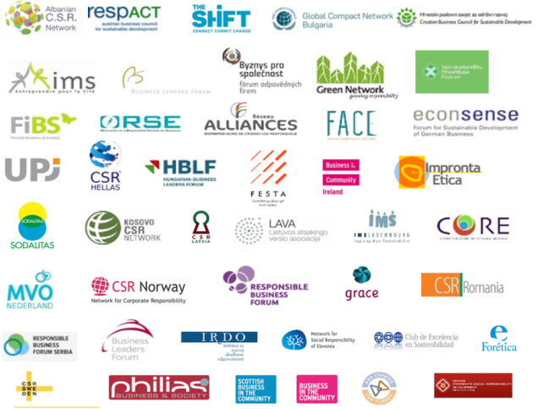
About CSR Europe
Leading business network for sustainability/corporate social responsibility
Gathers +10.000 companies through its network of multinationals and national partner associations
Platform for business to learn and act together
Working as a dialogue platform with the European Commission and other European stakeholders

Slide 4
Public Private Partnership

Slide 5
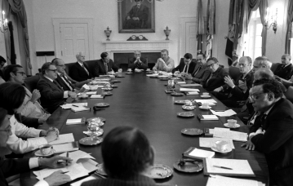
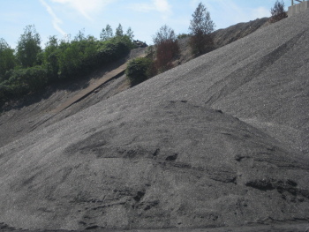
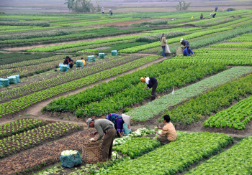
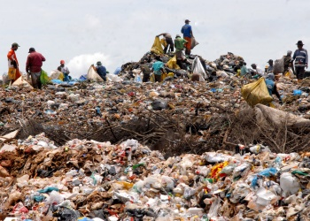
Challenging current climate
Globalisation and capitalism are challenged
Trust & confidence decline
Rise of populism
On-going environmental & social challenges
A more radical change
is required:
rethinking growth models
Sustainability needs to be the key driver for growth

Slide 6
UN Sustainable Development Goals
A Common Language for Collaboration and Innovation
Potential to unite towards common purpose
Policy makers: global, regional, national and local
Government agencies
Civil society
Companies
ACTION

Slide 7
Businesses and the SDGs
MORE SYSTEMIC CHANGE / TRANSFORMATION REQUIRED
2 requirements to implement/ leverage the Sustainable Development Goals
Internal transformation of companies – new business models
Collaboration – public/private; private/private; within value chain etc.

Slide 8
The Sustainable Business Exchange
Notes:
Tax responsibility, innovation, ect

Slide 9
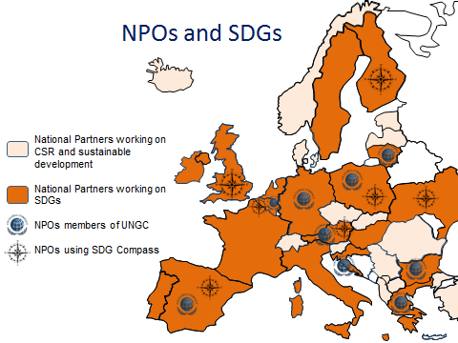
The Sustainable Business Exchange
Innovate
Learn to improve
Incubate innovateive practises
Dialogue with stakeholders
Notes:
Tax responsibility, innovation, ect

Slide 10
Part 2
The challenge
Finding and developing public/private partnerships

Slide 11
The Result
The ILO and the Turkish Ministry of Labour and Social Security jointly initiated a project focusing on the elimination of the worst forms of child labour in seasonal hazelnut harvesting, co-funded by the Association of Chocolate, Biscuit and Confectionery Industries of Europe (CAOBISCO) and the government of the Netherlands.
The action originated in the province of Ordu Region of Turkey in 2013. Following a successful first phase, the intervention was extended to several other provinces in 2015- 2017.

Slide 12
Public Private Partnerships
Build on the experience and achievements of partners –> increases impact
widespread awareness and mainstreaming decent work practices in the hazelnut sector
strong cooperation among key stakeholders at local, national and international levels
sustainable model achieved by dedicated team of experts, training of relevant staff and experts at local and national levels on the intervention strategy

Slide 13
PPP Recipe for success
Find partners who share your goals
Agree Rules, Roles and Responsibilities
Identify the win-win for all
Go with the flow sometimes and see where it takes you and your partners
Deliver on your promises – Build trust

Slide 14
Thank you for waiting....now its your turn
Paula Byrne
pb@csreurope.org
www.csreurope.org

